Slide 1
Coordinated Entry Shelter Plus Care Application Training
Presented by the Metro Homeless Impact Division

Slide 2
Shelter Plus Care (SPC) is a Housing Choice Voucher program that is administered locally by MDHA.
A household issued a Shelter Plus Care voucher is responsible for finding a market rate unit where the owner/landlord agrees to accept Housing Choice Vouchers. The SPC voucher then subsidies the rent of the unit. The SPC subsidy is paid directly to the landlord and the household pays any potential difference.

Slide 3
Shelter Plus Care vouchers are only available through Coordinated Entry. Only certain agencies are able to submit SPC applications due to their ability to provide support services for the duration of the voucher.
The agencies able to submit SPC vouchers are Park Center, Safe Haven, Centerstone, Mental Health Cooperative and Nashville Cares.

Slide 4
Eligibility Criteria
Literally
Homeless (Cat. 1)
Entered into Coordinated Entry
Households are selected from By-Name-List (BNL) based on prioritization protocol
Verifiable disabling condition
* If a client is receiving RRH, they are still considered literally homeless. If a client is receiving RRH, the CE Entry can have an Exit with housed destination. Households receiving RRH will not be represented on BNL but will still be selected based on prioritization protocol.

Slide 5
Reasons for denial
Any household member has been convicted of a felony-related, alcohol related, violent criminal activity in the past 12 months
Any household member has been convicted of 2 or more misdemeanor or felony drug-related, alcohol-related, violent criminal activity in the past 12 months
Any household member has 3 or more convictions for a misdemeanor or felony drug-related, alcohol-related, violent criminal activity one of which is less than 3 years old
Any household member has one or more convictions for a felony sex offense in the past 10 years or any conviction of a sex offense involving a minor
Any household member is convicted of a drug-related or violent criminal activity that allegedly occurred on or near MDHA premises

Slide 6
Reasons for denial
Currently owes rent or other amounts to any housing authority in connection with MDHA/Section 8 programs
Have a household member who has been evicted, or moved to avoid eviction, or have been terminated from MDHA/Section 8 for a negative reason in the last 12 months
Have a household member who has been convicted of manufacturing or producing methamphetamines (DENIED FOR LIFE)
Have a household member with a lifetime registration under a State sex offender registration program (DENIED FOR LIFE)

Slide 7
Referral Process
Households will be referred to a SPC voucher from the By Name List (BNL) and based on the prioritization protocol.
If you are navigating someone that is referred to SPC, you will receive an email from NashvilleCES@Nashville.gov stating that the household has been referred and is able to submit a SPC application through CE.

Slide 8
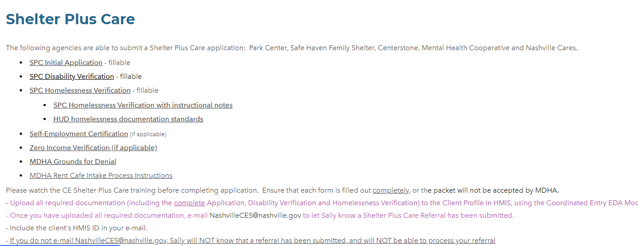
Weebly Screenshot
https://hmisnashville.weebly.com/forms-and-applications.html

Slide 9
How to apply
MDHA packet
Includes MDHA packet, HMIS intake form and MDHA release
Disability verification
Supporting Documents
(not inclusive)
Front and Back State ID – All Adults
Front and Back SSC – All Members
Homelessness verification
Birth Certificates – All Members
Proof of Income (see checklist)
Proof of Non-Cash Benefits
Upload into HMIS
Recommendations:
Do NOT fill out application until you have all documents. Application expires after 90 days
HN should fill out application with client.

Slide 10
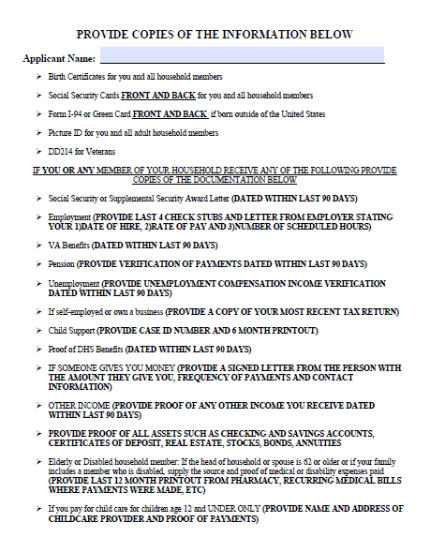
MDHA packet
A MDHA packet and Homelessness Certification with instruction notes is uploaded onto the Weebly website

Slide 11
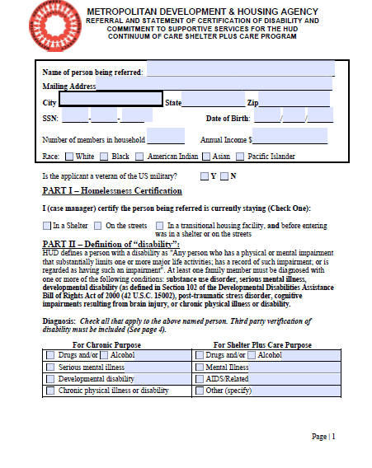
Homelessness Verification
Homelessness must be verified for Shelter Plus Care applications.
A Homelessness Certification with notes can be found on the Weebly website.

Slide 12
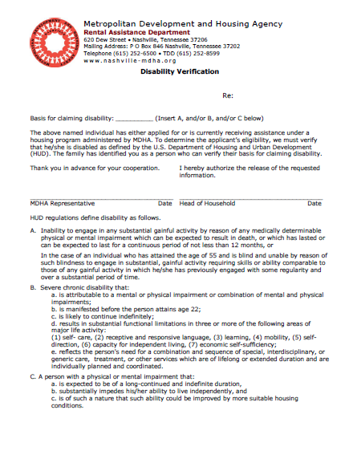
Disability verification
Proof of disabling condition can be SSI/SSDI print out OR completed MDHA Disability Verification form

Slide 13
Uploading application

Slide 14
How to apply
Receive email that referral to SPC has been made
Email
Nashville CES NashvilleCES@nashville.gov
MHID will review/provide edits/refer to MDHA
Upload in HMIS
MDHA will review and either approve or deny
If approved, briefing dates will be emailed to each Navigator

Slide 15
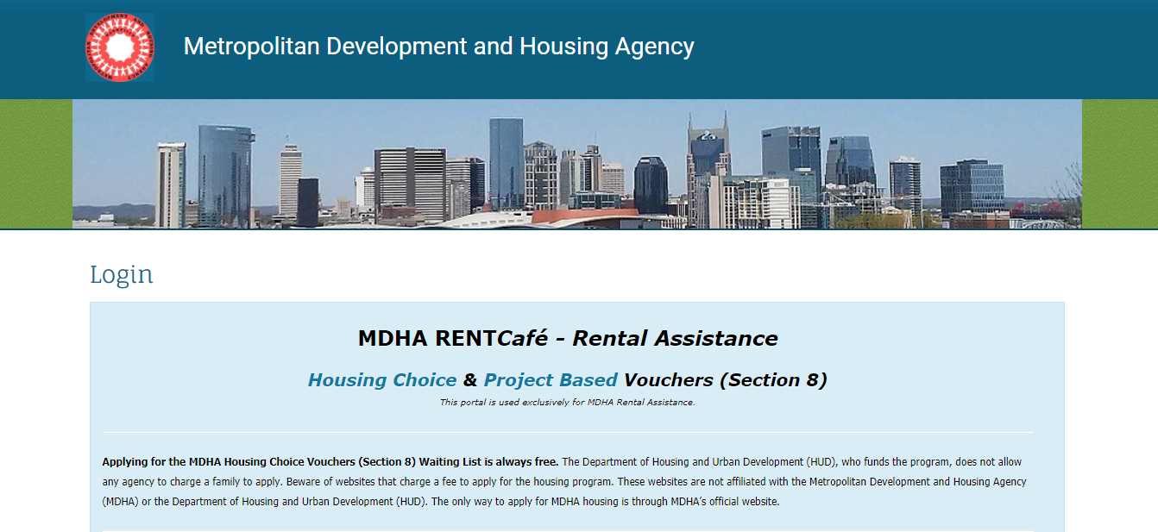
How to apply through Rent Cafe
For certain applicants, MDHA might request applications be submitted through their online portal, Rent Café. You will be notified if you are working with a household that will be submitting their application through Rent Cafe.

Slide 16
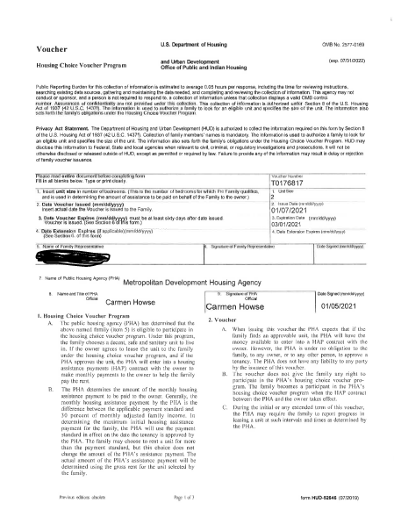
Once approved
Congratulations!
The household has been approved for a Shelter Plus Care voucher. They will be assigned a SPC briefing date and receive their voucher and other briefing materials at this time.

Slide 17
Thank you for completing this training!
Please email any questions you have about the Shelter Plus Care application process to NashvilleCES@Nashville.gov

