Slide 1
Coordinated Entry (CE) Data Entry Training Guide Metro Homeless Impact Division Updated June 2022

Slide 2
What is HMIS?
HMIS stands for Homeless Management Information System. An HMIS is a web-based software application that collects and reports on client-level information for people who are served by projects intended to prevent and end homelessness.
HMIS collects information about who your clients are, when you served them, what their circumstances are when they enter your project, whether they change, and what services you are providing.

Slide 3
Why Use HMIS?
Every Continuum of Care (CoC) is required to have a single HMIS in order to receive funding from the Dept. of Housing and Urban Development (HUD)
HMIS is used to measure project effectiveness, generate an unduplicated count of homeless persons for the CoC, and help understand the extent and nature of homelessness and patterns of service use.
The more agencies that participate, the better we are able to provide services and demonstrate our community’s effectiveness in ending and preventing homelessness!

Slide 4
Data Sharing
Nashville HMIS allows for system-wide data sharing unless otherwise specified by specific agencies, projects or individual clients.
Data sharing enhances our ability as a community to effectively collaborate around our clients needs.
It is crucial for this reason that each user and participating agency holds data safety and security as a top priority.
Notes:
Definition from VA.gov.

Slide 5
Privacy and Security Reminders
Always log out of HMIS when you leave your desk.
Choose a strong password and do not share it or write it down.
Review the release of information form with your clients thoroughly.
Ensure that the Privacy Notice is posted in intake areas and explained to clients so that they understand how their data will be used.
Notes:
Definition from VA.gov.

Slide 6
Important Resources
HMIS URL (save as a bookmark!): https://sp5.servicept.com/MHIDNashville
HMIS Website: hmisnashville.weebly.com
HMIS Help Desk: HMISHelp@nashville.gov
HMIS Administrator: Hannah Cornejo-Nell (hannah.cornjeo-nell@nashville.gov)
HMIS Education, Training & Oversight Coordinator: Megan Vickers (megan.vickers@nashville.gov)
HMIS User Support Specialist: Chantelle Owens
(chantelle.owens@nashville.gov)

Slide 7
Before You Start…
In order to enter a client in HMIS, you must have a signed Release of Information (ROI) or verbal consent granted from the client

Slide 8
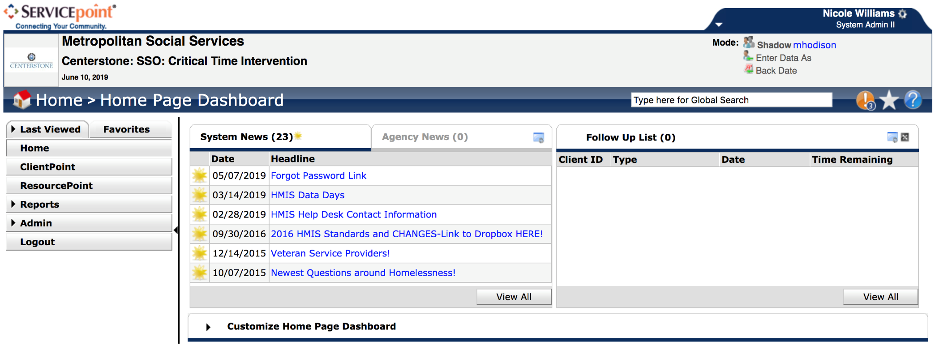
Homepage
Your username
Your agency’s name
Enter Data As (EDA)
ClientPoint
Back Date
News!

Slide 9
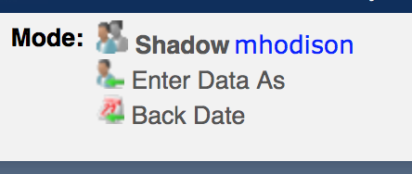
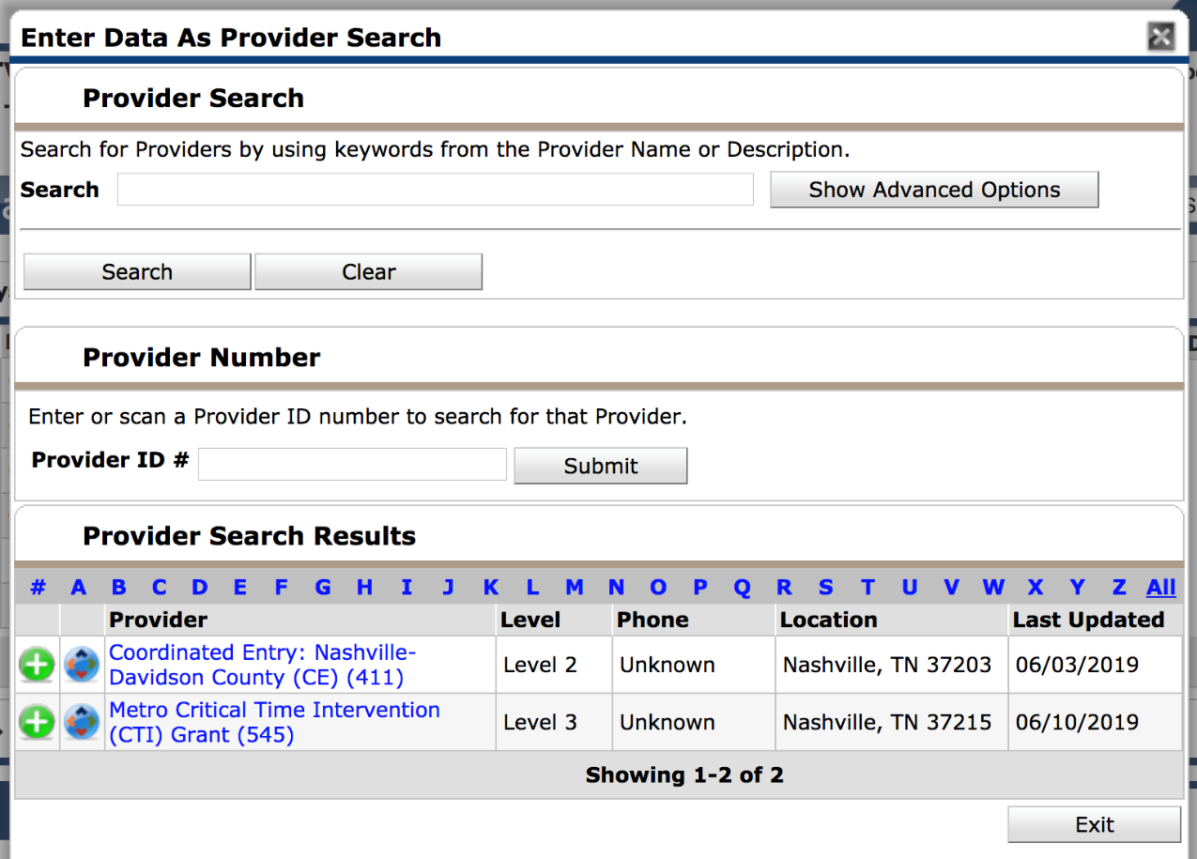
Always the first step: EDA Mode
1. After you log in, first find and click “Enter Data As” (EDA) at the top right of the page. The provider you select here is where your data will be stored – you are “Entering As” that provider and associating the client with it.
Enter Data As (EDA)
2. Select the program where the client you’re entering belongs by clicking the green circle with the plus sign.

Slide 10
EDA Tips
Selecting the correct EDA mode is an important step you need to take every single time you enter data for a client!
Especially if you’re entering multiple clients in a row, you should make frequent checks to that top-right section of the screen to ensure that you’re in the EDA mode that you meant to be in.
If you realize you have entered a client’s information under the wrong EDA mode, you will need to contact the HMIS Help Desk to delete the data. Then you’ll have to start over, using the correct EDA mode – so pay close attention!

Slide 11
ClientPoint – Searching for a Client
Before entering a new client, you are required to first search the system to see if that client already has a record in HMIS (in order to avoid duplication).
Enter the client’s first & last name and click “Search.”
Note: If you do not find a match using the client’s name, add the client’s SSN and click “Search” again.
Notes:
Reasons a client may already have a record in the system:
If someone at your agency has added the client to the system
If the client has received services at another agency (remember that clients are universal, and there are 20+ agencies entering into the system)

Slide 12
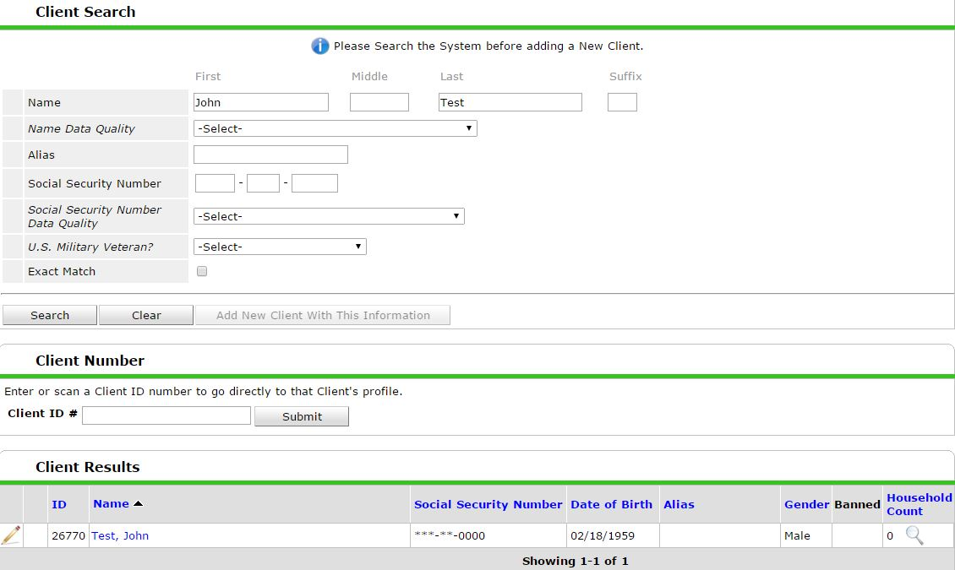
ClientPoint – Searching for a Client
If the client has a record in the system, their name will appear under “Client Results.” If they are a match based on name, SSN, and DOB, select the pencil to edit or add to the client record.
Tip: If you already know the client’s ID #, you can type it in to the Client ID # box and click “Submit.” This will take you right to their record.
Notes:
Note: if the client looks like they might be a match, but one or two numbers or off, or name is slightly different – use the existing client record. You can always update the information once you start editing the record.

Slide 13
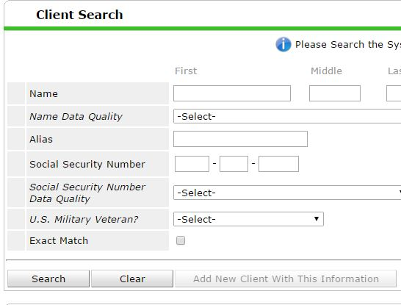
ClientPoint – Adding a New Client
The system will not allow you to add a new client until you have at least done a basic search by name.
If no client exists after you have tried searching their name and SSN, you may add them as a new client.

Slide 14
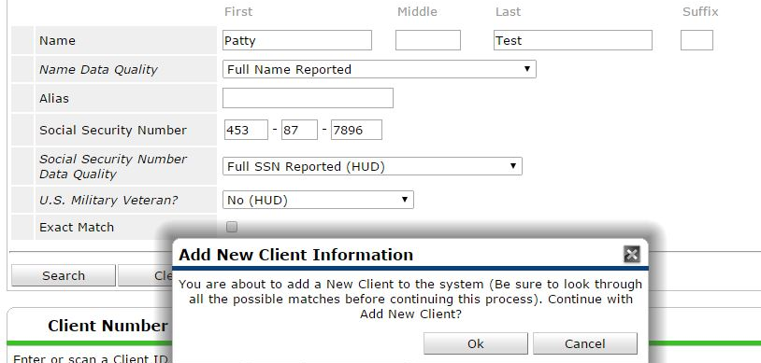
ClientPoint – Adding a New Client
To add a new client, enter all client information (First Name, Last Name, Name Data Quality, SSN, SSN Data Quality, and US Military Veteran?) and click “Add New Client With This Information.”
Follow proper capitalization rules!
Full First & Last Name = “Full Name Reported”
Click Ok.

Slide 15
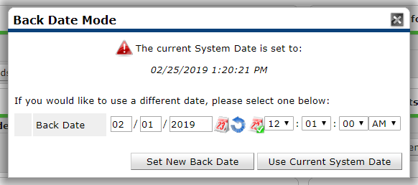
Client Record – Back Date Mode
After adding a client or selecting a client record to edit, you will see a “Back Date Mode” pop-up. Back date mode is just simply a time stamp of when your information was collected. You should NEVER enter data without a back-date mode set.
Back Date = The date something occurred (for example: assessment date, date a service was provided, the date a resident completed an activity, the date you completed an annual update, etc.)

Slide 16
Client Record – Back Date Mode
Remember: Always use Back Date Mode!
If you collected information today, today is your back-date. If you collected data last week, that date will be your back-date.
Enter the desired date.
Leave time as is! (12:01:00 AM)
Click Set New Back Date to continue.

Slide 17
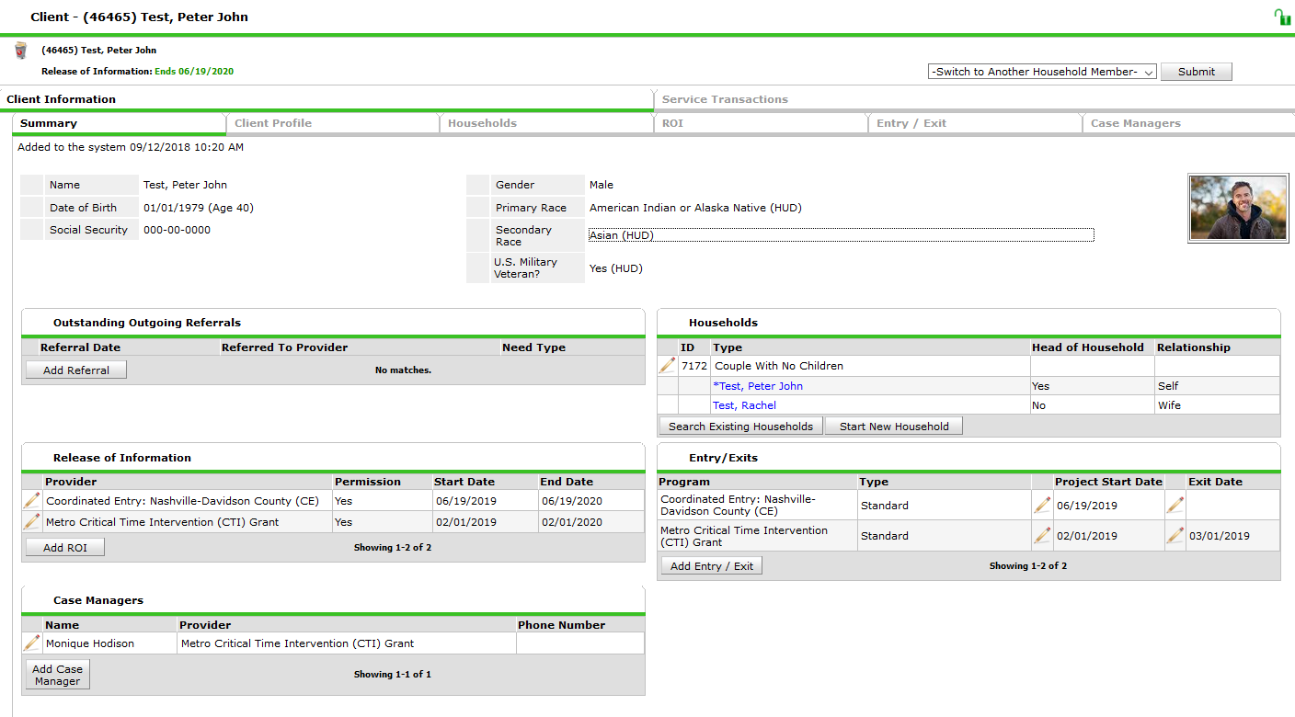
Client Information – Summary Tab
You will land on the Summary tab, which gives you an overview of the information in the client’s record.
The Client ID# can be used to quickly navigate back to the client’s record in the future.
This tab will be empty if you are creating a new client but will fill in as you add information to the record in the different tabs.

Slide 18
Client Profile Tab
Client Demographics
Client Photo
Client Notes
File Attachments

Slide 19
Client Profile Tab
Use the Client Profile tab to complete or correct demographic/identifying information, add a photo (if available), and upload documents.
Note: Most users can only see the last 4 of SSN. Contact your agency’s Point of Contact if you believe the entire SSN is incorrect.

Slide 20
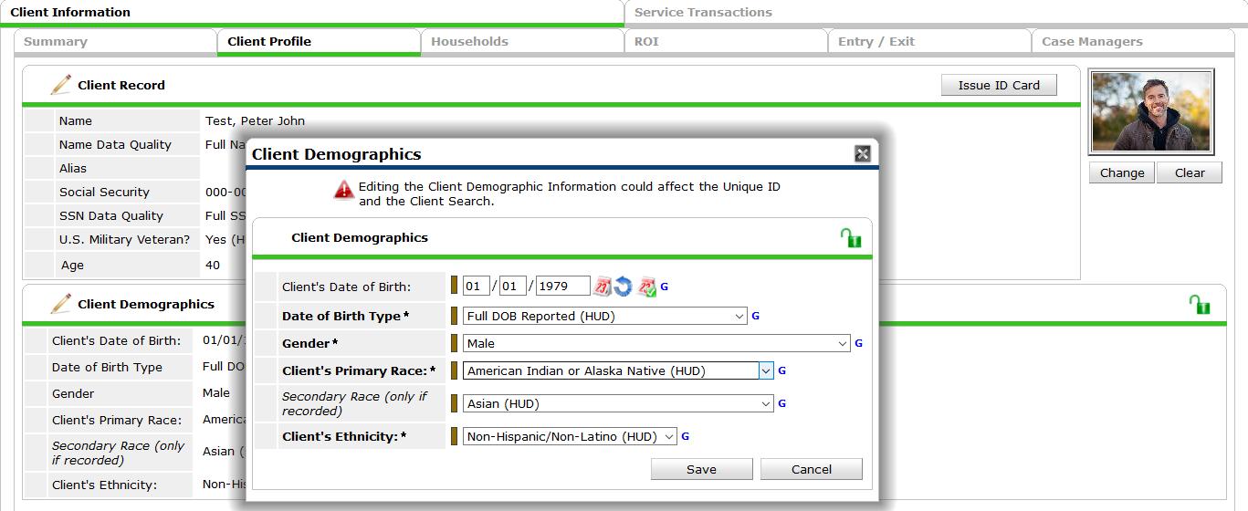
Client Profile Tab – Client Demographics
Make sure all information is completed. Click the pencil to edit existing information including the “data quality” questions
If client reports one race, leave Secondary race blank.
***At this time, the answers available in HMIS for race and ethnicity are the only HUD recognized options. Hopefully this list becomes more comprehensive soon!

Slide 21
Client Profile Tab – File Attachments
Use File Attachments (at the bottom of the Client Profile tab) to upload housing-related documents. (ROI’s uploaded later in the ROI tab)
Click Add New File Attachment to select a document from your computer.
Files should be named using this naming convention:
“Last Name_First Name_Document Type”
Choose a File, then click Upload.

Slide 22
Client Profile Tab- Client Notes
Case notes live on the client profile tab. They should be utilized by any project type to add information that could help collaborate or coordinate services for the client across agencies.
For Coordinated Entry, helpful case notes include any of the following pieces of information:
Where is the client in the housing process?
What barriers exist for the client to work towards housing.
What documents are needed to apply to resources
Connector cards- any client who has a connector card needs an update note added every two weeks. Case notes entered for this reason should begin with “Connector Card update”

Slide 23
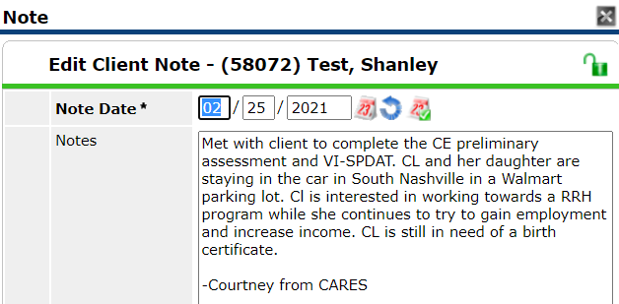
Client Profile Tab- Client Notes
Make sure you are in the correct EDA mode and Back-date mode.
If you hover on the note icon, the whole note will pop up.
Make sure to sign off with your name and agency in each case note.
Notes added to maintain a client’s Connector Card should begin with “Connector Card update”

Slide 24
Client Profile Tab – Client Photo
If you have obtained permission to upload a client photo, click “Change” to upload an image. This photo is used primarily for Connector Cards, however it can also be helpful in street outreach coordination.
Click Browse to select an image from your computer. (Must be a JPEG or PNG file, not a PDF.)
Then click Upload.

Slide 25
Households Tab
Create households with multiple members
If you’re working with a single individual, skip this tab!

Slide 26
Households Tab
If the client has other members in their household, click on the Households tab.
According to HUD a “household” is any group of people that want to live together. This could be relatives or non-relative groupings of people.
If you are working with an individual, you will skip this tab.

Slide 27
Households Tab
Check to see if the client is already in a household. If the household exists, you are finished in the tab. If multiple households are listed and one of them is correct, you are finished in the household tab.
If there is no household listed click “Start New Household”
**** If during a client’s enrollment in a project, the household composition changes, look to the training guidance available on the https://hmisnashville.weebly.com/ for how to update manage the household in HMIS.

Slide 28
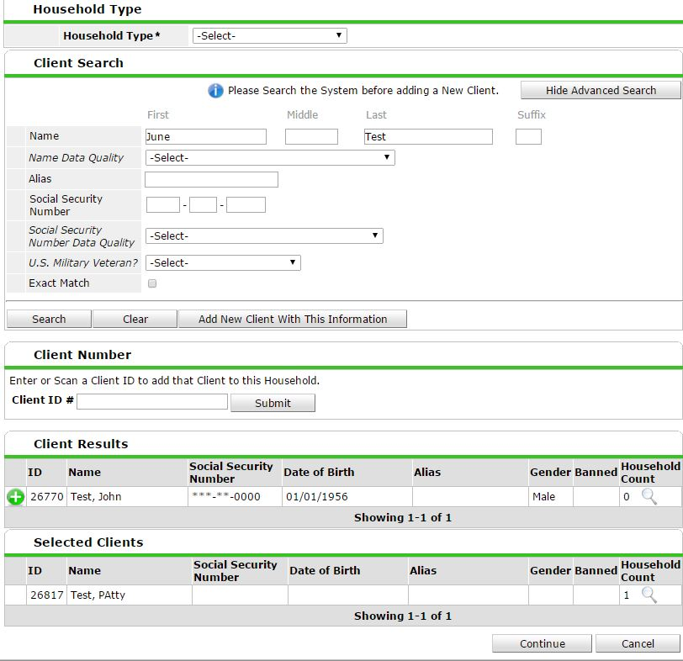
Households Tab – New Household
Click “Start a New Household.”
1. Select the Household Type.
2. Search for a family member. If they already exist in the system, they will populate under “Client Results.” If they don’t already exist, select “Add new Client with This Information.”
3. Once you find/create the family member, click the green circle with the plus in order to add them to the household.
4. Repeat for each household member.

Slide 29
Households Tab – New Household
Answer “Yes” to the “Head of Household” (HoH) question for the head of household.
For every other family member, select their relationship TO the head of household. Only ONE household member listed as Head of Household.
3. “Joined Household” date pre-populates to back-date (do not edit).
4. Save & Exit.

Slide 30
ROI Tab
Every household member age 18+ must sign their own ROI.
Minors will be listed on the Head of Household ROI and tagged on the HoH’s ROI tab.
Even though you’ve uploaded the ROI, you still must electronically indicate that there is an ROI on file! We call this “Electronically tagging the ROI”.

Slide 31
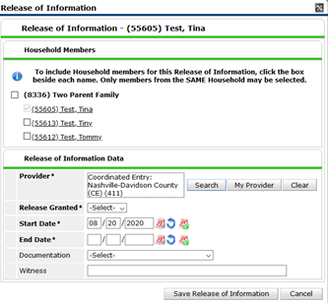
Tagging the ROI
Include all household members that are listed on the ROI.
The EDA mode you are in will be listed as the Provider. Click “Search” and a screen with additional providers will pop up. Unless the client opted out of data sharing, you will always need to also tag “1 Universal ROI” as a provider. (Next slide)

Slide 32
Tagging ROIs
This ROI sub-assessment will pop up.
1. Click the green + button next to “1 Universal ROI” to add it to the other provider listed. This will make the ROI visible to any program or provider using HMIS.
2. The “1 Universal ROI” will show up at the bottom with the other Provider.
3. Once both are listed, click the “Exit” button.

Slide 33
If you have collected a ROI select “Yes” for release granted. (You should not be entering data if there is no ROI
The ROI is valid for 3 years. Set the end date.
Identify whether there is a signed ROI or if verbal consent was granted (An upload of an ROI is required regardless)
Sign as the witness. This adds another level of accountability for client data.
Click “Save release of information”

Slide 34
ROI tab
You will upload the ROI here on the Universal ROI line.
Once you have clicked “Save” the ROI tab should now look like this below.
You will see the ROI expiration date listed.
Both providers should be tagged.
.

Slide 35
Entry/Exit Tab
Entries and exits show a client’s participation in different projects.
You may see several entries that the client is currently engaged in, or has previously engaged in.

Slide 36
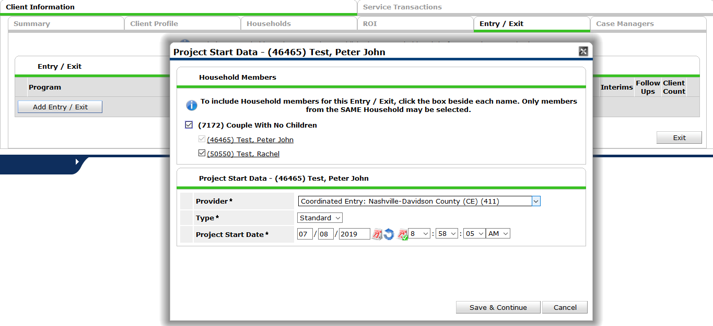
Entry/Exit Tab – Add an Entry
1. Click “Add Entry/Exit.”
2. Include each household member by checking the box next to their name (if applicable).
The “Provider” will default to the EDA mode you have selected. Do not change this.
3. For the “Type” dropdown, choose “Standard.”
4. The Project Start Date (Entry Date) will correlate to the Back-date mode you selected for the date of assessment.

Slide 37
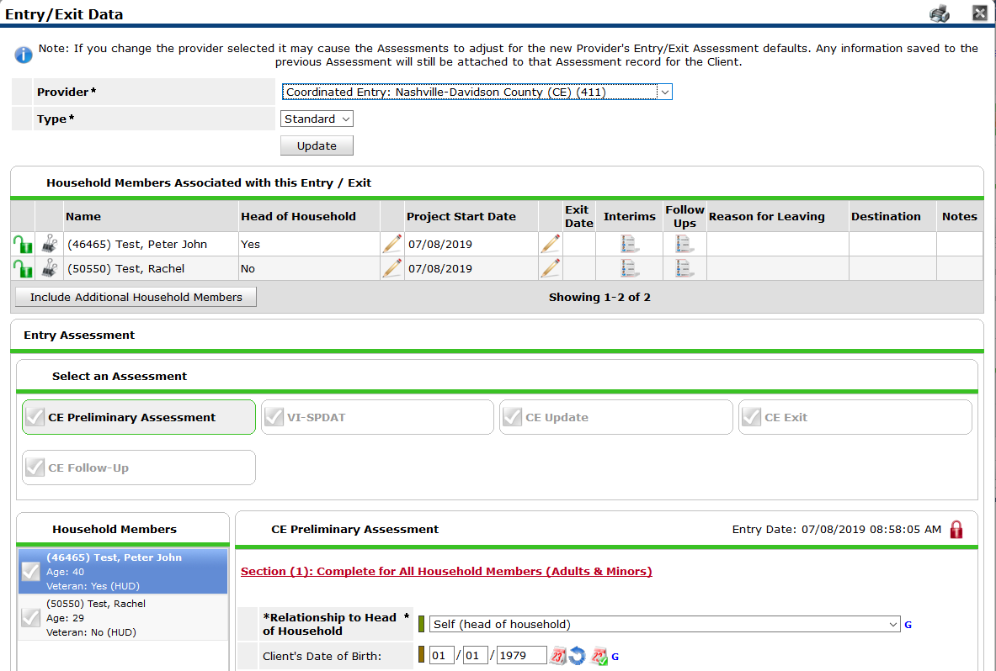
Entry Assessment
Pay attention to Section Headings! These will tell you which data elements must be completed for Head of Household only; All Adults in Household; or All Household Members (Adults & Minors)
The name highlighted blue is the client record you are currently working in.

Slide 38
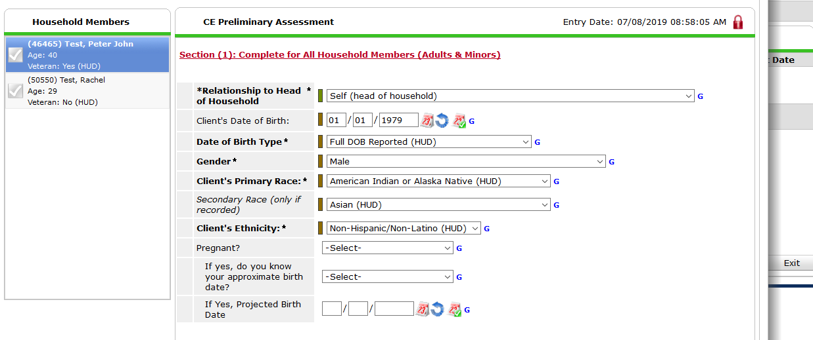
Entry Assessment – Section 1
1. Make sure to complete all demographic information.
2. Pregnancy question should be asked to any members of the household who can biologically become pregnant. If it doesn’t apply, SKIP.

Slide 39
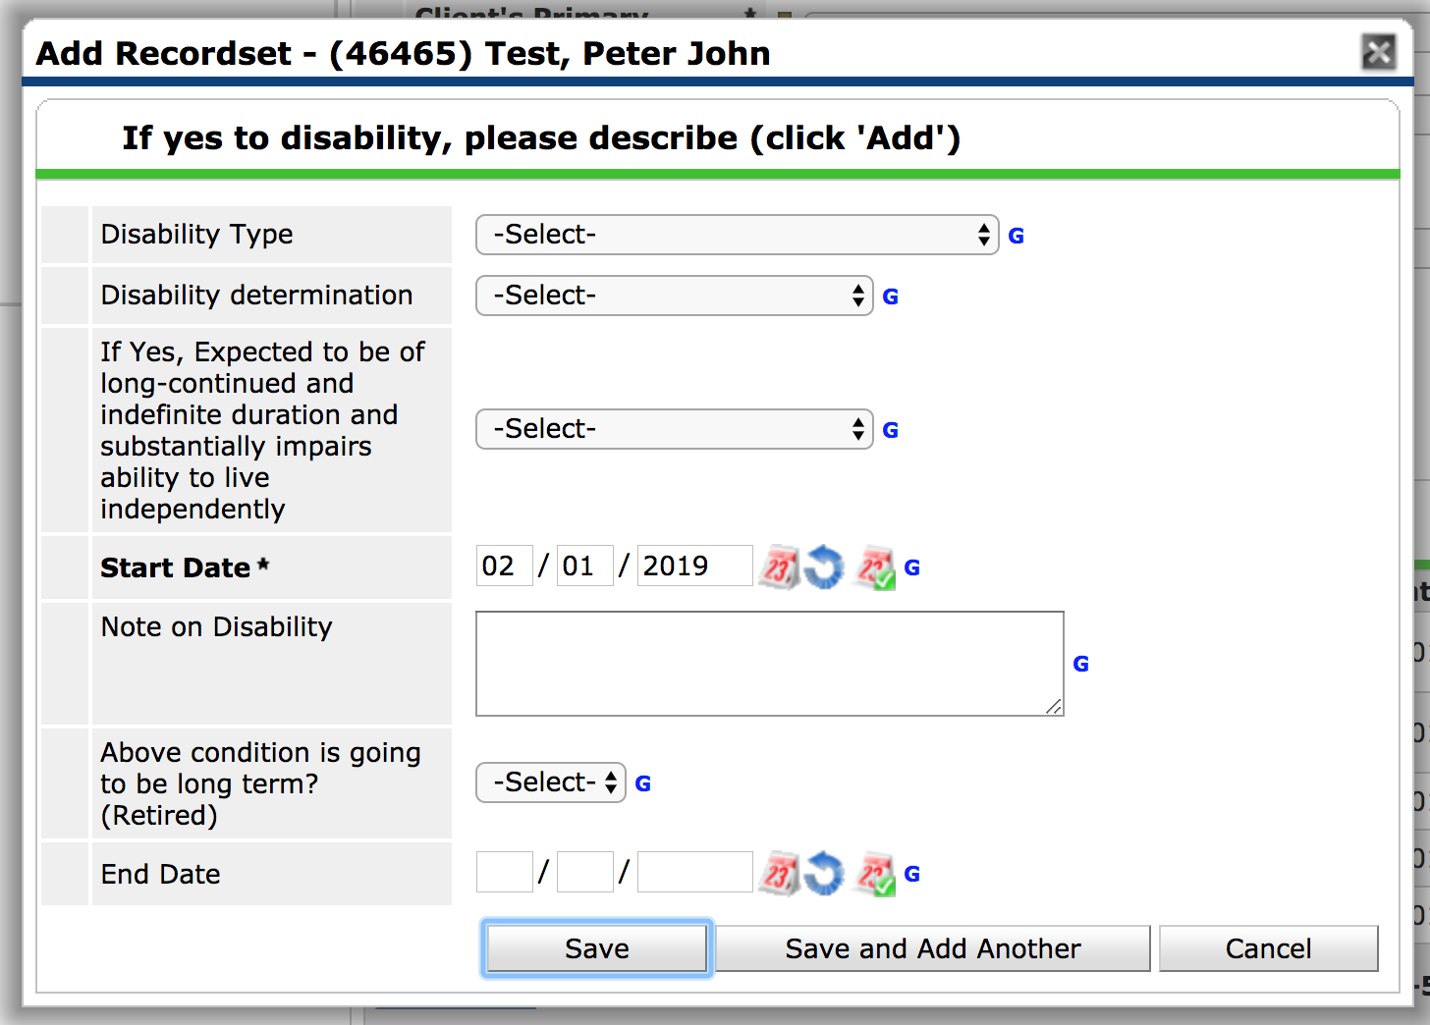
Entry Assessment – Disabling Conditions
1. On Disability pop-up, select Disability Type. Only select responses with (HUD) after them!
2. Answer “Yes” for Disability Determination.
If you answered “Yes” to Does the Client Have a Disabling Condition, click “Add.”
3. Start Date is pre-populated with Back Date.
Check to make sure this = program enrollment date.
4. Leave End Date blank.
5. If client has more than one disabling condition, click “Save and Add Another.” Otherwise, just click “Save.”
6. After saving, click the Red Triangle to complete HUD Verification.

Slide 40
Entry Assessment – Disabling Conditions
Remember: information in HMIS is self-reported. If client reports no disabling conditions, even if you know they have a disabling condition, you should record their response as “No.” This can be updated later, if they choose to share that information.
Do not record client’s specific diagnosis anywhere in HMIS!
Only choose options with (HUD) after them.
If client reports both Alcohol and Drug Abuse, enter separate records for Alcohol Abuse (HUD) and Drug Abuse (HUD).
If client reports more than one disabling condition in a single category, enter multiple records with the same Disability Type (e.g., Bipolar Disorder & Generalized Anxiety Disorder → two “Mental Health Problem (HUD)” responses).

Slide 41
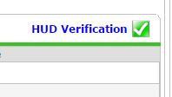
HUD Verification
1. You must complete the HUD Verification sections (regardless of whether you answered “yes” or “no” that the client received any).
2. After adding any insurance source, click the “HUD Verification” red triangle.
3. Once you see this screen, select “No” at the top (this confirms that the client does not have any of the disabling conditions that you did not select). This will fill in “no” for every answer choice that you did not choose.
4. Save & Exit.
5. You’ll end up with a green check!

Slide 42
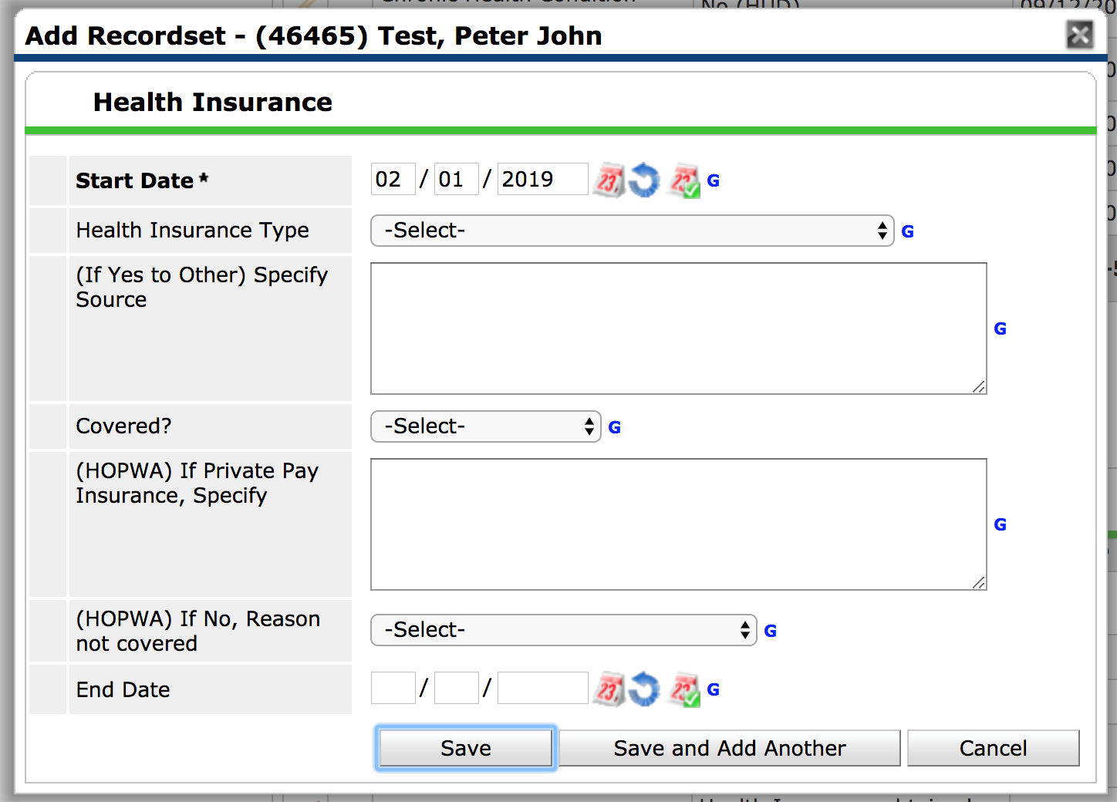
Entry Assessment – Health Insurance
Follow the same steps for Health Insurance.
Start Date auto-populates to Back Date. Leave End Date blank.
Select the Health Insurance Type from the dropdown (if “Other,” specify.)
Select “Yes” for “Covered?”
Don’t forget HUD Verification!

Slide 43
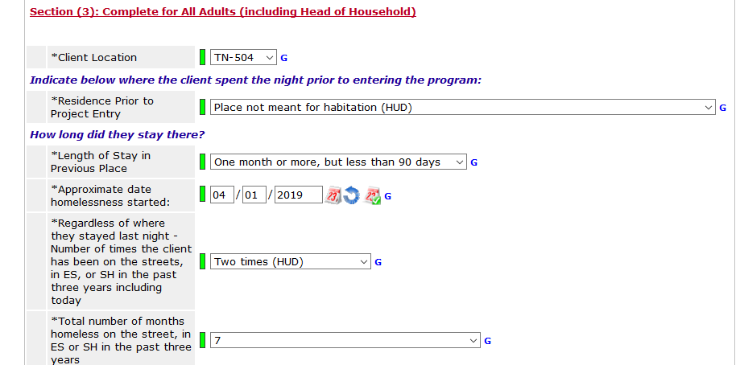
Entry Assessment – Homeless History
1. Client Location is ALWAYS TN-504.
2. Residence prior to project entry is asking where did the client sleep last night. Based on how you respond, questions pertaining to that response will populate.
3. Length of Stay in previous place, is how long has the person been in the placement that was entered in the Residence Prior to Project Entry field.
4. Approximate date homelessness started, is for this episode of homelessness

Slide 44
Entry Assessment – Income
Income = regular, recurring sources of income
Lump sums should not be recorded (e.g., disability back-payment, court settlement)
Very sporadic work should not be recorded
If needed, take the average of several months’ paystubs to determine a monthly amount.
Food Stamps are not Income (those are recorded as Non-Cash Benefits).
If a minor child in the household receives income (e.g., through a job, disability), record that in the Head of Household’s assessment.

Slide 45
Entry Assessment- Income
2. This should be the grand total of all cash income sources for the client.
1. Select yes or no.
3. If client is receiving cash income, add the sources here. Anything you add should equal the number listed for step 2. (See next slide for adding new source)
4. Always HUD Verify!

Slide 46
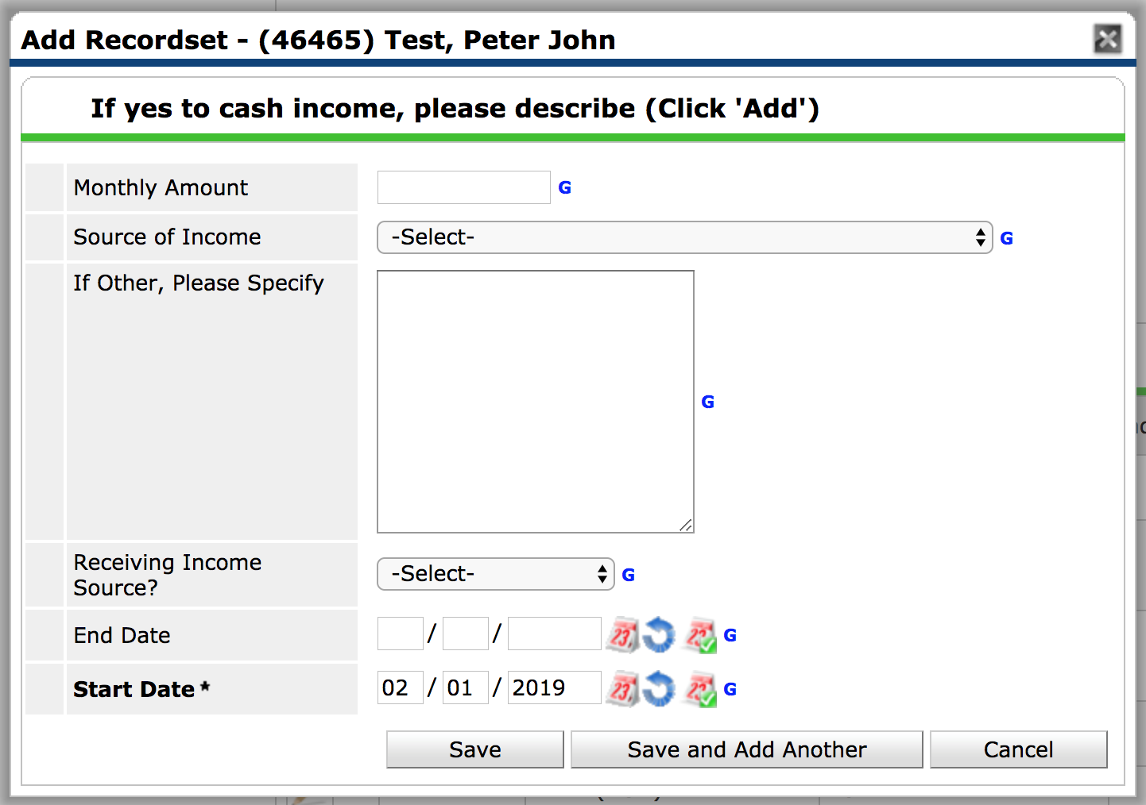
Entry Assessment – Income
1. Enter monthly income amount.
2. Select appropriate source of income. Always select the option with (HUD) following it.
3. Select “Yes.”
4. Leave end date blank. Start Date is pre-populated with Back Date.
NOTE: If the client already has an income source listed in their entry assessment, but they are no longer receiving it, click on the pencil next to that income source to edit. Add an end date of the day before program enrollment date. Leave “Receiving Income Source?” as “Yes.”
Don’t forget HUD Verification!
Notes:
Update Screen Shot

Slide 47
Entry Assessment – Non-Cash Benefits
Follow the same steps for Non-Cash Benefits.
NOTE: If the client already has a non-cash benefit source listed in their entry assessment, but they are no longer receiving it, click on the pencil next to that income source to edit. Add an end date of the day before program enrollment date. Leave “Receiving Income Source?” as “Yes.”
Don’t forget HUD Verification!

Slide 48
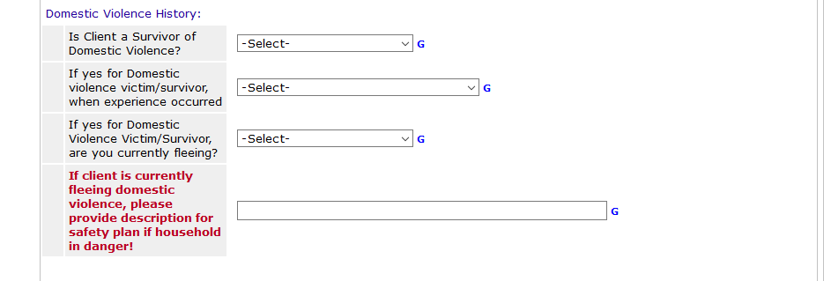
Entry Assessment – DV Questions
If you answer “Yes” to the first question, answer the remaining questions. The questions build off one another. Make sure to discuss at your agency about safety planning if your client is experiencing or fleeing from domestic violence.

Slide 49
Section 3
Select the answer that best matches where the CE assessment took place. Email the help desk if you think an answer is missing.
If your client is literally homeless and answers yes, a VI-SPDAT may be completed. Both MUST be true to complete a VI-SPDAT.

Slide 50
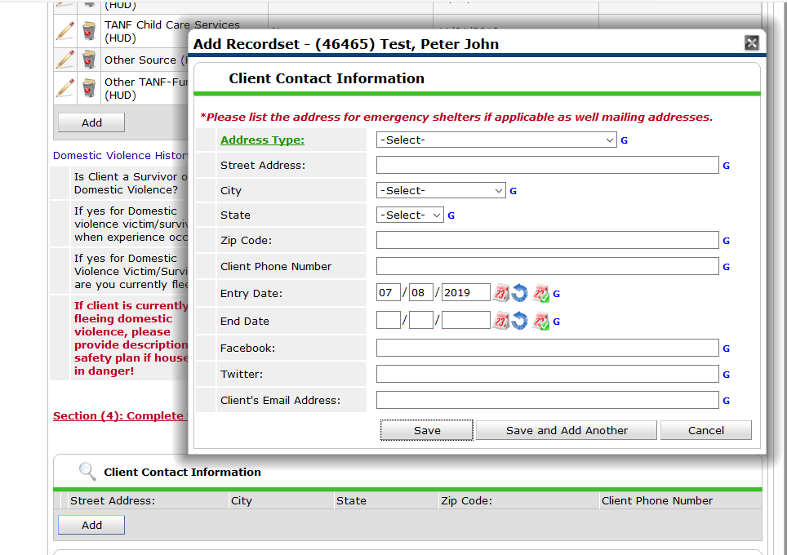
Entry Assessment – Client Contact Information
Fill out what you have, there are different types of address types. Phone number and email are key. For Facebook and Twitter, follow your agency policy!
You will click “Add” to add a contact, you can add as many as needed.

Slide 51
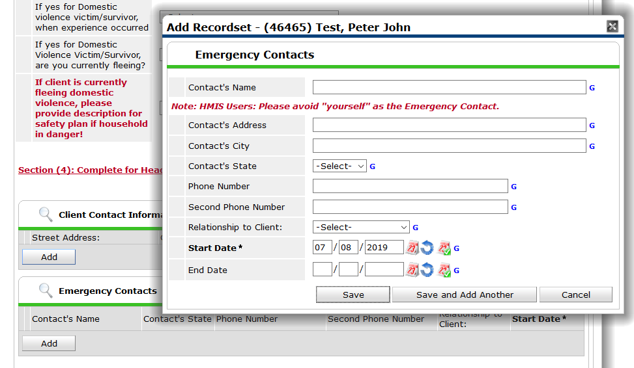
Entry Assessment – Emergency Contacts
Emergency Contacts should be just that, for an emergency.
You will click “Add” to add a contact, you can add as many as needed.

Slide 52
Current Living Situation (CLS)
The current living situation is very important. This determines if a person is literally homeless and eligible for certain resources.
CLS determines if a person should open or closed in CE. It should be updated at minimum every 90 days. Best practice is to update the question each time you confirm the living situation, even if it has not changed.
The first time you create a client record the answer will be the same as what you answered for “Homeless history questions”. However this should be updated anytime a client’s living situation changes or is verified through a contact.

Slide 53
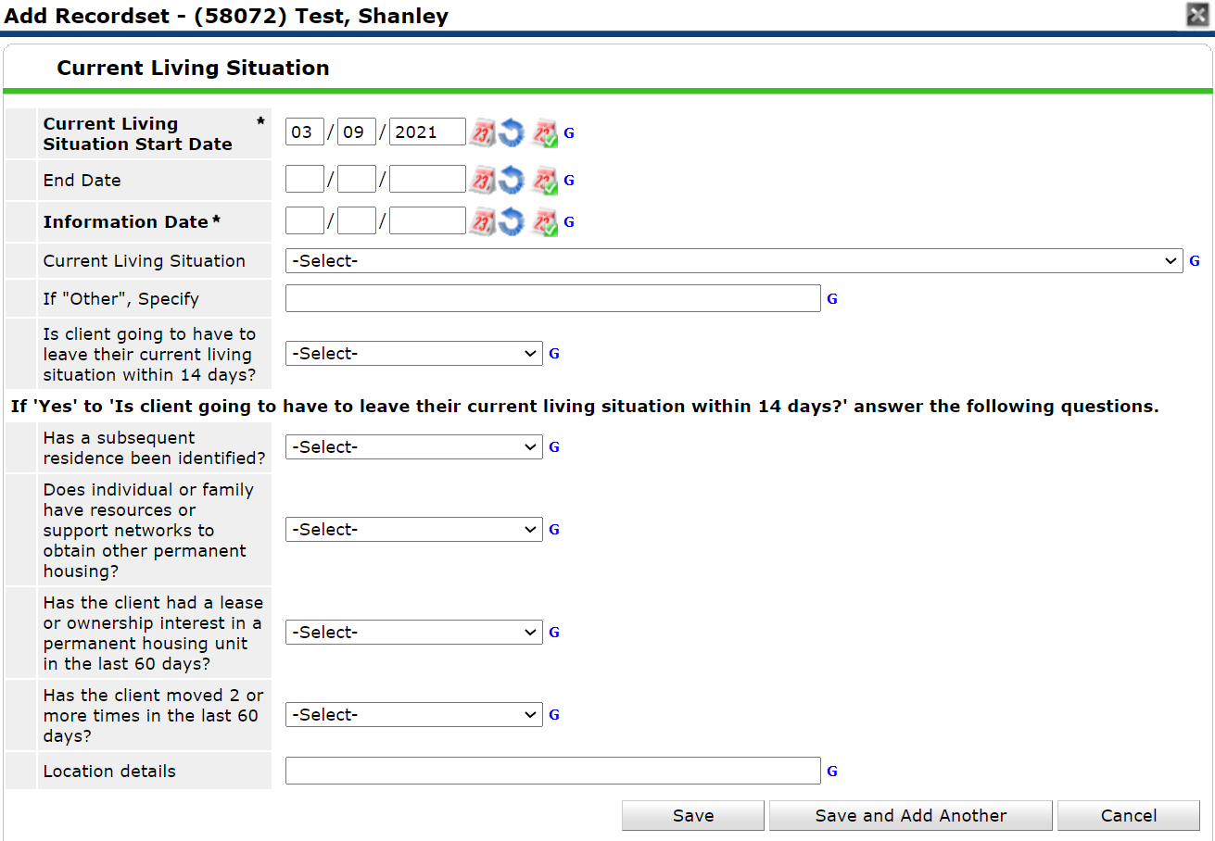
CE Current Living situation
Answer each question.
If the client will have to leave their current living situation within the next 14 days, complete the Diversion questions.
Make sure to answer this question each time you verify the client’s living situation.

Slide 54
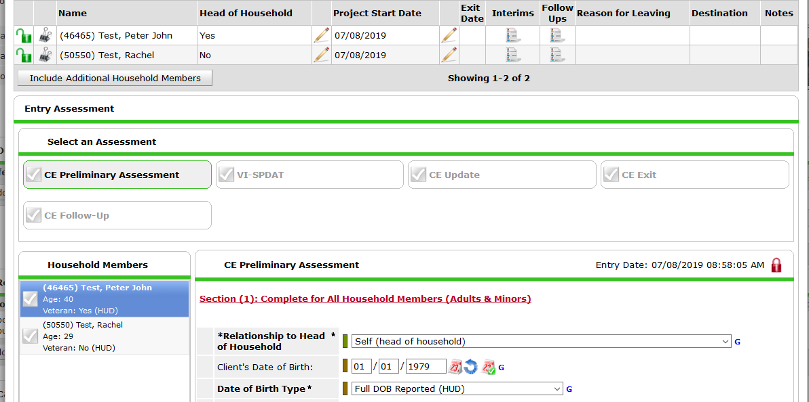
Entry Assessment – DO NOT FORGET other Household Members
If there is more than one member of the household, scroll up, click on each remaining household member’s name and complete their Entry Assessment.
Remember: Read Section Headings to clarify which data elements need to be collected for additional household members!

Slide 55
Wrapping up your CE Entry
If you have entered answers for every relevant question for all household members you can click “Save and Exit” at the bottom of the assessment.
If you will also be completing a VI-SPDAT, look to next slide.

Slide 56
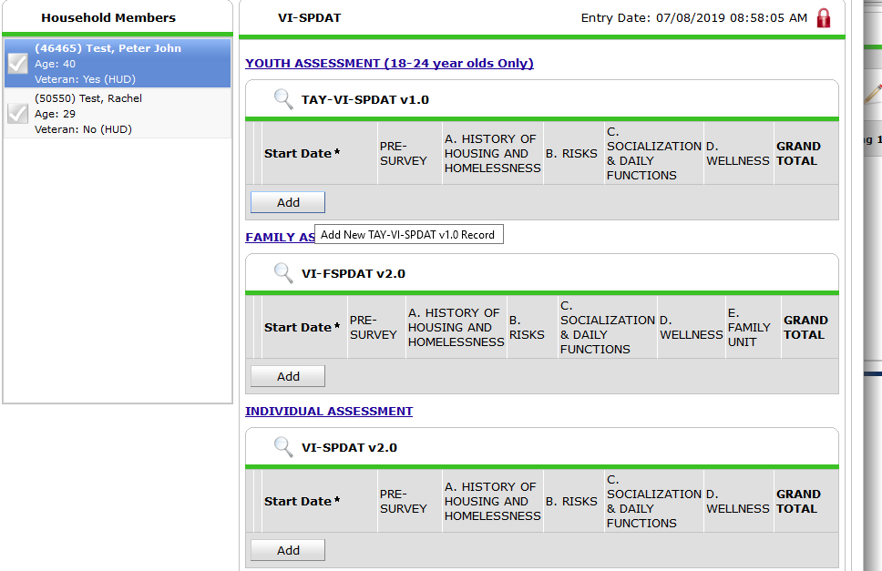
VI-SPDAT
1. Once you have saved your CE Preliminary Assessment, you will then scroll all the way to the top.
2. If your client is literally homeless (street, shelter, place not meant for human habitation) and indicated that they want to work towards housing you will complete a VI-SPDAT. Make sure to click on the VI-SPDAT Assessment Tab.
3. You will “add” the appropriate VI-SPDAT.
TAY-VI-SPDAT for INDIVIDUALS 18-24 years old.
VI-FSPDAT is for FAMILIES WITH MINOR CHILDREN
VI-SPDAT is for INDIVIDUALS, can include couples, families with just adults, etc.

Slide 57
Tagging the VI-SPDAT
If you are completing a VI_SPDAT you will also need to tag it here by clicking “add”.

Slide 58
Tagging the VI-SPDAT
Complete this assessment. In Nashville, the VI-SPDAT is used as a housing needs assessment, which then triggers the client to be placed on the “Prioritization List”. Above is how you should answer.

Slide 59
Case Manager Tab
How to tag yourself or someone else as actively working with someone in HMIS.
Make sure you are in the EDA mode that represent the program the client is working with you in.
Street Outreach EDA will override CE

Slide 60
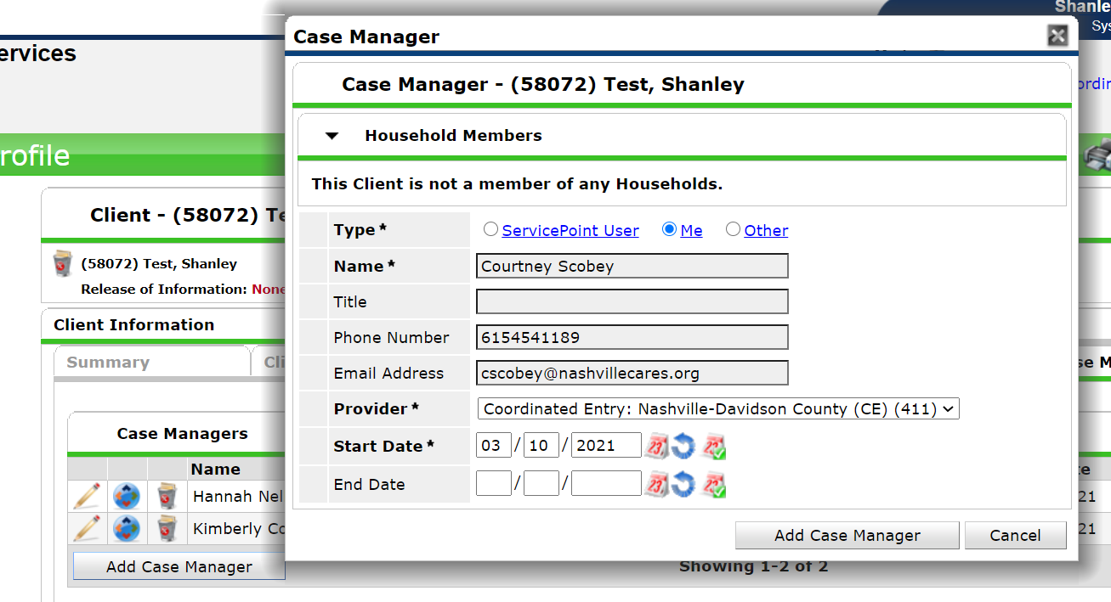
Case Manager tab
Click “Me” if you are going to work with a client in any formal capacity (as a housing navigator, case manager, SO worker, etc.).
Click “Other” if you want to tag someone else that will be working with someone. You will have to manually enter the name and contact information if you choose this option.

Slide 61
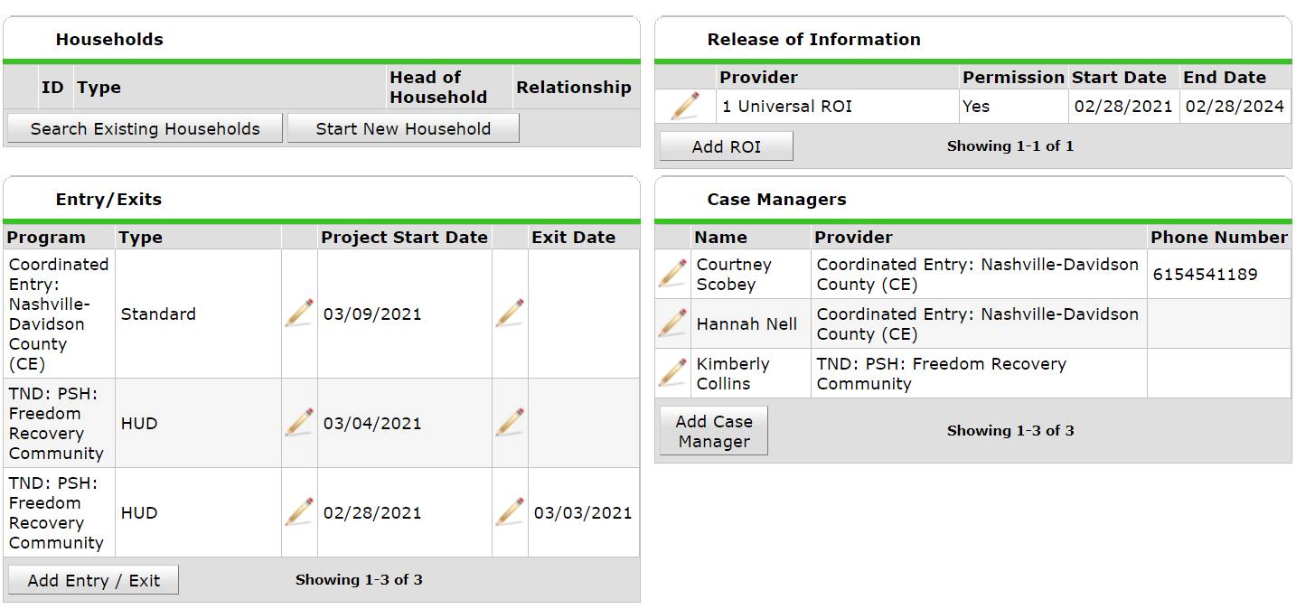
Case Manager
Now that you’ve added a case manager, the information will be visible on the client’s summary tab.

Slide 62
Entry/Exit Tab
Updates
Exits

Slide 63
Interim Updates
When the Interim Update Assessment loads you will notice it looks very similar to the Entry Assessment. All fields will be pre-populated with information from the Entry Assessment (or last interim update if one has been added).
Update anything and everything that has changed since the entry or last interim update.
Do not change previous case notes, housing situations, contacts, just ADD new.
Remember to add a Case Note, indicating any updates and any changes that were made and sign off with your name and agency.

Slide 64
Entry/Exit Tab – Interim Updates
Choose appropriate Enter Data As mode.
ClientPoint: Enter HMIS ID in “Client ID #” field to directly locate the client’s record.
Back Date Mode: Back date to date of Update. This could be the date you met with a client, called a client, learned of changes in client information, etc.
Click on “Entry/Exit” Tab.
Click on form icon under “Interims.”

Slide 65
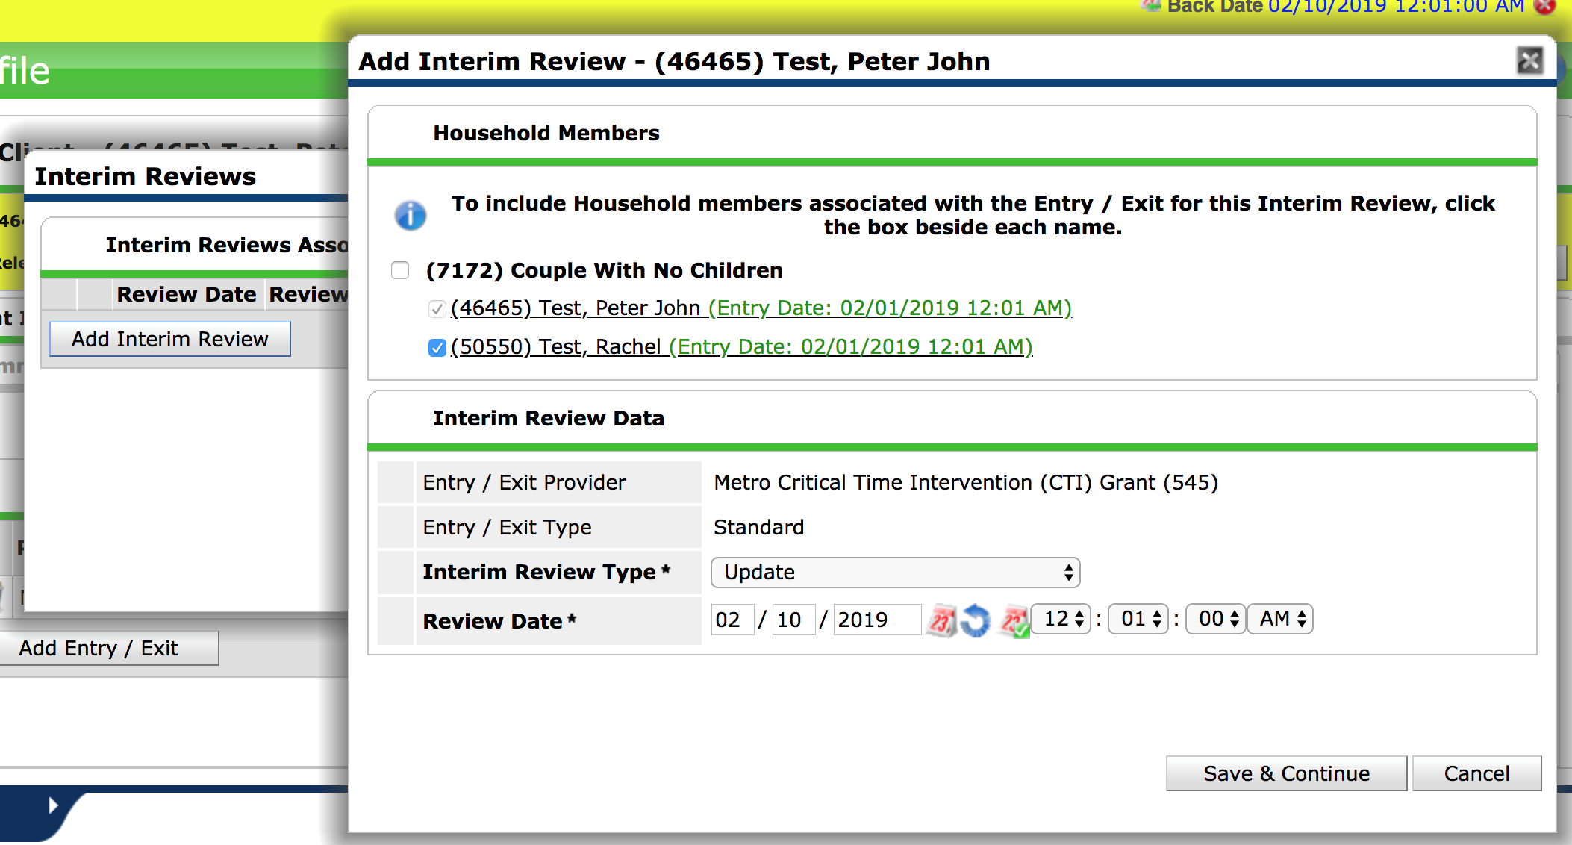
Entry/Exit Tab – Interim Updates
1. Click “Add Interim Review,” and another pop-up box will appear.
2. Make sure relevant household members are tagged.
Select “Update” for Interim Review Type.
3. Review Date will pre-population with Back Date. Do not change date or time stamp.
4. Save & Continue.
5. Make any updates to the client’s record and save.

Slide 66
Entry/Exit Tab – Exit Assessment
Choose appropriate Enter Data As mode.
ClientPoint: Enter HMIS ID in “Client ID #” field to directly locate the client’s record.
Back Date Mode: Back date to Exit Date.
Click on “Entry/Exit” Tab.
Click on pencil icon under “Exit Date.”
Remember for CE you should not exit a person unless they are permanently housed or being marked as inactive. If they are exiting your program due to non-compliance but are still homeless, DO NOT EXIT THEM FROM CE.

Slide 67
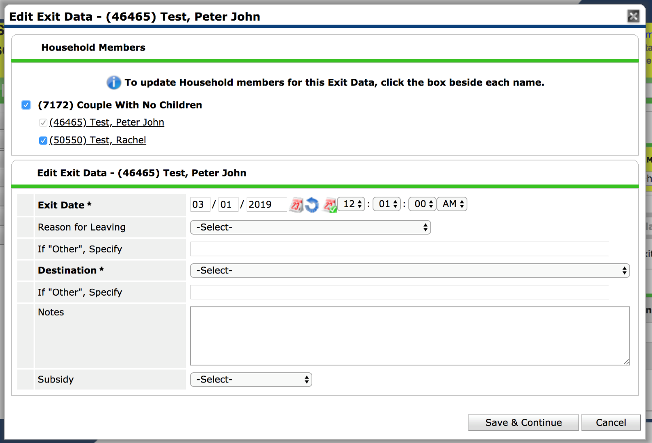
Exiting a Client
1. Include each household member in the Exit by checking the box next to their name (if applicable).
2. Exit Date will pre-populate with Back Date. Do not edit date or time stamp.
3. Select “Reason for Leaving” and “Destination” (if “Other,” specify). Avoid choosing “Other” if possible. “Reason for Leaving” should only be “CE Exit: Permanently Housed” or “CE Exit: Inactive.”
4. Save and Continue.

Slide 68
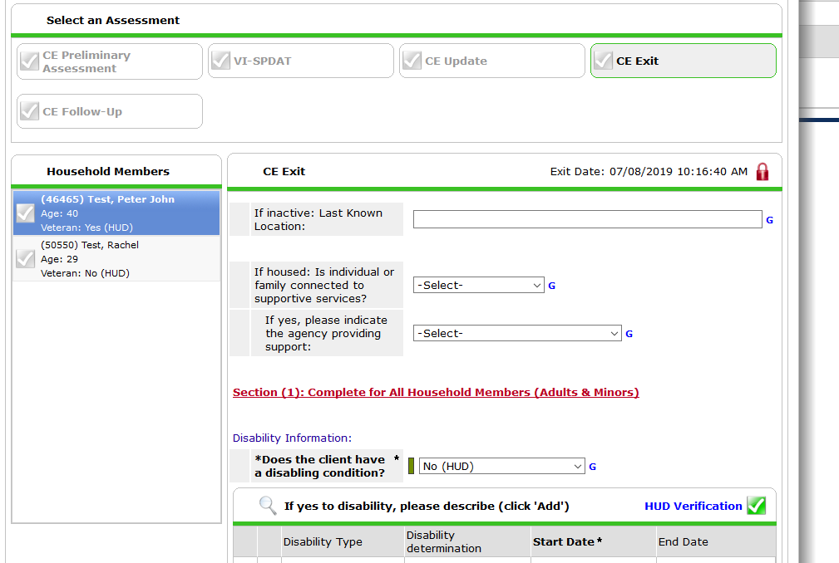
Exiting a Client
Make sure to answer relevant questions.
The Exit Assessment looks similar to the Entry Assessment. All fields will be pre-populated with information from the Entry Assessment or the last update.
If no exit interview was completed (e.g., because client disappeared), do NOT update any fields. Leave all fields as they were at entry.
Make any necessary changes to Disabling Condition, Health Insurance, Income, Non-Cash Benefits, and DV status for all household members.

Slide 69
Questions?
Contact the HMIS Help Desk: HMISHelp@Nashville.gov

