Slide 1
HMIS Training Guide SSVF Metro Homeless Impact Division Software: ServicePoint Updated June 2022

Slide 2
What is HMIS?
HMIS stands for Homeless Management Information System. An HMIS is a web-based software application that collects and reports on client-level information for people who are served by projects intended to prevent and end homelessness.
HMIS collects information about who your clients are, when you served them, what are their circumstances when they enter your project, whether they change, and what services you are providing.
Notes:
Definition from VA.gov.

Slide 3
How Data is Organized in HMIS
IMAGINING HMIS AS A NEIGHBORHOOD
To get a better understanding of the way information is stored in HMIS, imagine the HMIS system as a neighborhood. All of the information collected by service providers in Nashville lives in this neighborhood. Different streets in the neighborhood represent different agencies – for example, let’s say the neighborhood has Safe Haven St., Centerstone SSVF Ave., Nashville Cares Way, Park Center Blvd. On each street there are many houses, representing the different programs that each agency (street) contains – for example, on Centerstone SSVF Ave. there’s a house called Homelessness Prevention, as well as a house called Rapid Rehousing since they run both of those programs. Every time you, the user, enter information into HMIS, you will always be entering that information into a specific house on a particular street.
A client in Nashville may receive services at any “house” on any “street” over the course of time. For example, perhaps they were a part of Centerstone SSVF’s Rapid Rehousing program a year ago, but now they’re receiving services from the Salvation Army. The Salvation Army HMIS user will be entering that client’s information into a different “house” than the SSVF HMIS user had entered into previously. The information from both programs all lives within the same neighborhood, but it does not flow freely from street to street. *Note: Since the Nashville/Davidson County HMIS is not an “open system” at this time, HMIS users at one agency cannot view the details of services a client has received at any agency other than their own. You can only view the services and entries and exits that your agency has provided. You can view information entered in other houses on your street, but not on other streets in the neighborhood.
Notes:
Definition from VA.gov.

Slide 4
Privacy and Security
Always log out of ServicePoint when you leave your desk.
Choose a strong password and do not share it or write it down.
Review the release of information form with your clients thoroughly.
Notes:
Definition from VA.gov.

Slide 5
Resources
VA Programs HMIS Manual: https://www.hudexchange.info/resources/documents/VA-Programs-HMIS-Manual.pdf
HMIS URL (save as a bookmark!): https://sp5.servicept.com/MHIDNashville
HMIS Help Desk: HMISHelp@nashville.gov

Slide 6
Before You Start…
For you to be able to enter a client in HMIS, there must be a signed Release of Information (ROI) on file.
Remember: slow down and pay attention to data quality!

Slide 7
HMIS Homepage
Your username
Your agency’s name
Back Date
Enter Data As (EDA)
ClientPoint

Slide 8
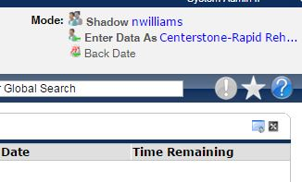
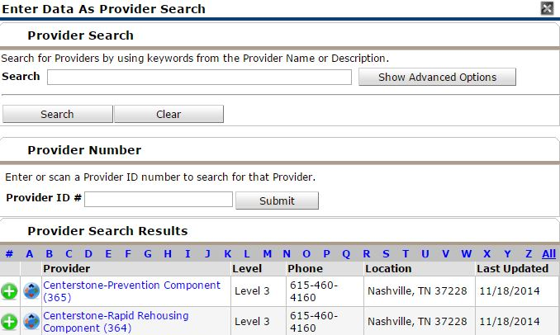
Always the first step: EDA Mode
1. After you log in, first find and click “Enter Data As” (EDA) at the top right of the page. The provider you select here is where your data will be stored – you are “Entering As” that provider and associating the client with it.
Enter Data As (EDA)
2. Select the program where the client you’re entering belongs by clicking the green circle with the plus sign.

Slide 9
EDA Tips
Selecting the correct EDA mode is an important step you need to take every single time you enter a client!
Especially if you’re entering multiple clients in a row, you should make frequent checks to that top-right section of the screen to ensure that you’re in the EDA mode that you meant to be in.
If you realize you have entered a client’s information under the wrong EDA mode, you will need to delete and start over – so pay close attention!

Slide 10
ClientPoint
ClientPoint is HMIS’s search tool.
After selecting the correct EDA mode, search for an existing client or enter a new one by clicking on ClientPoint.

Slide 11
ClientPoint – Searching for a Client
Before entering a new client, you are required to first search the system to see if that client already exists in HMIS (in order to avoid duplication).
Type their name and click “Search.”
If there are multiple matches to the name, add the client’s SSN and click “Search” again.

Slide 12
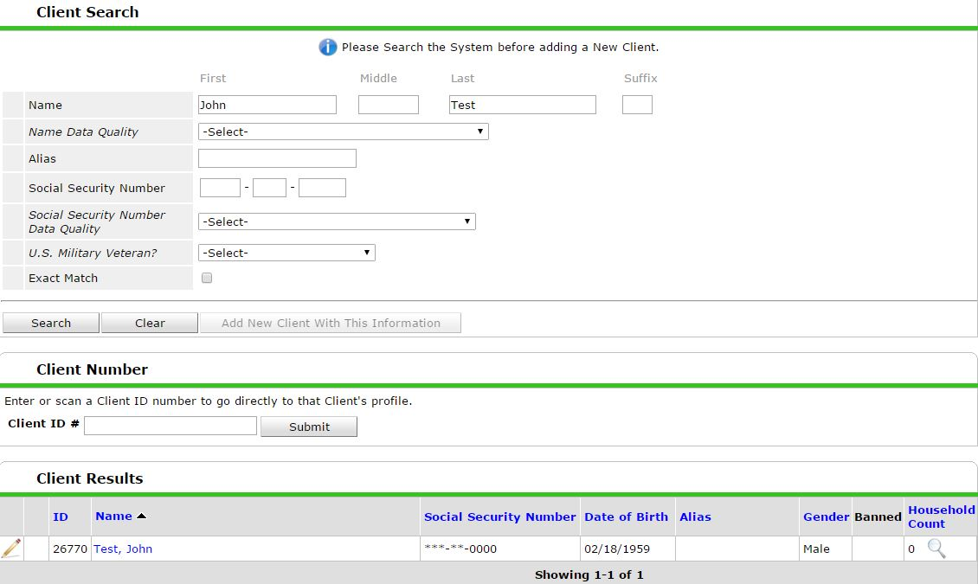
ClientPoint – Searching for a Client
If the client exists in the system, their name will display under “Client Results.” If they are a match based on name, SSN, and DOB, select the pencil for editing.

Slide 13
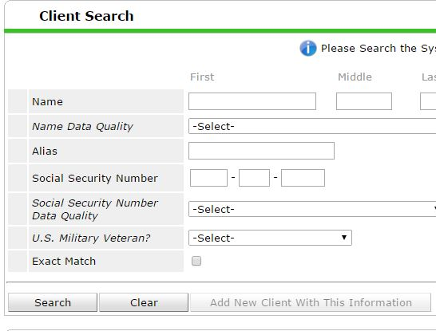
ClientPoint – Searching for a Client
The system will not allow you to add a new client until you have at least tried to look up the client’s name.
If no client exists after you have tried searching their name and SSN, add them as a new client.

Slide 14
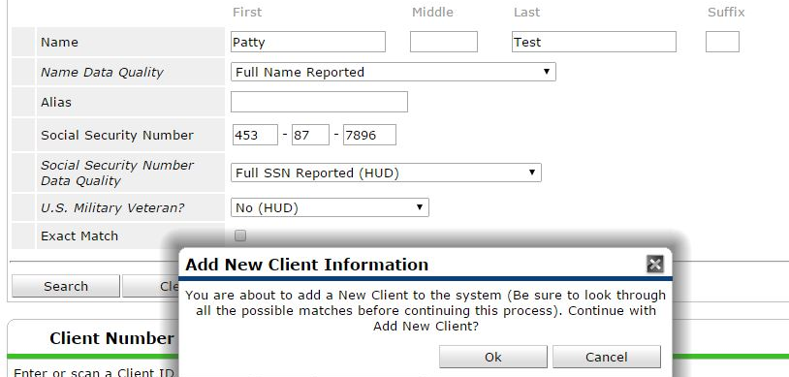
ClientPoint – Adding a New Client
Enter all client information (First Name, Last Name, Name Data Quality, SSN, SSN Data Quality, and US Military Vet?) and click “Add New Client With This Information.”
Click “Ok”

Slide 15
ClientPoint – Back Date Mode
After adding a client or selecting a client record to edit, the “Back Date Mode” window will pop up.
Back Date = The date something occurred (for example: the date you provided a service, the date a resident completed an activity, the date you completed an annual update, etc.)
Back Date to the client’s project Entry Date. Leave the time as is at 12:01:00AM.

Slide 16
ClientPoint – Back Date Mode
Remember: Always use Back Date Mode!
Enter the desired date.
Leave time as is! (12:01:00AM)
Click Set New Back Date to continue.

Slide 17
Client Information – Summary Tab
You will land on the Summary tab, which gives you a snapshot of much of the information in the client’s record.
The Client ID# can be used to quickly navigate back to the client’s record in the future.
Yes (HUD)

Slide 18
Client Profile tab
Use the Client Profile tab to complete or correct any demographic/identifying information about the client.
Note: Most users can only see the last 4 digits of the SSN. Contact your Agency Administrator if you believe the entire SSN is incorrect.

Slide 19
Client Profile tab
Make sure all information is completed. Click the pencil to edit existing information.
If client reports NO Secondary Race, leave this field BLANK.

Slide 20
Households tab
If the Veteran has any family members, click on the Households tab next.
Skip this tab if the client is a Single Veteran.

Slide 21
Households tab
Check to see if the client is already in a household. If the household exists, select it.
Note: If a household already exists in HMIS, but the household makeup has changed, create a new household instead of adding/subtracting members from the previous household.
If the client is not already in a household, select “Start New Household.” (See next slide)

Slide 22
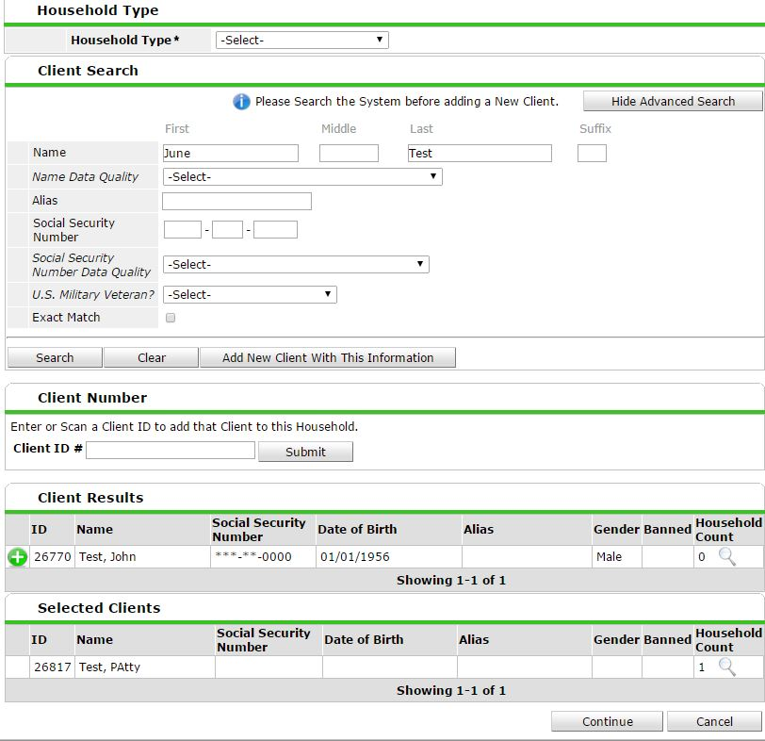
Households tab – New Household
Click “Start a New Household.”
1. Select the Household Type.
2. Search for a family member. If they already exist in the system, they will populate under “Client Results.” If they don’t already exist, select “Add new Client with This Information.”
3. Once you find/create the family member, click the green circle with the plus in order to add them to the household.
4. Repeat for each household member.

Slide 23
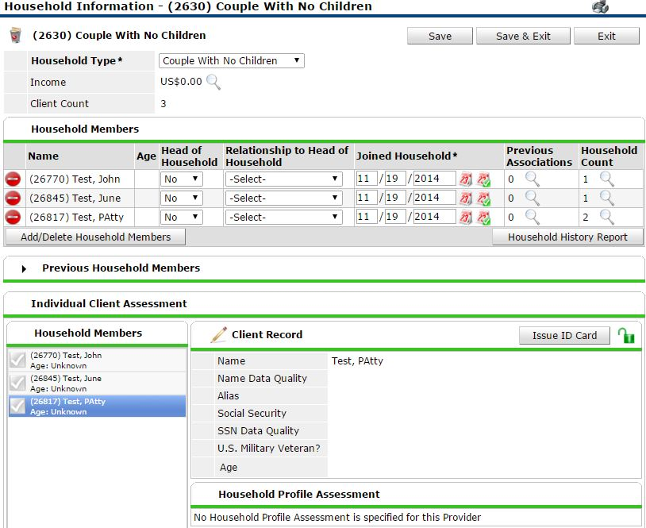
Households tab – New Household
Answer “Yes” to the “Head of Household” (HoH) question for the veteran.
For every other family member, select their relationship TO the head of household. The veteran should be the ONLY household member listed as Head of Household.
3. “Joined Household” date pre-populates to back-date (do not edit).
4. Save & Exit.

Slide 24
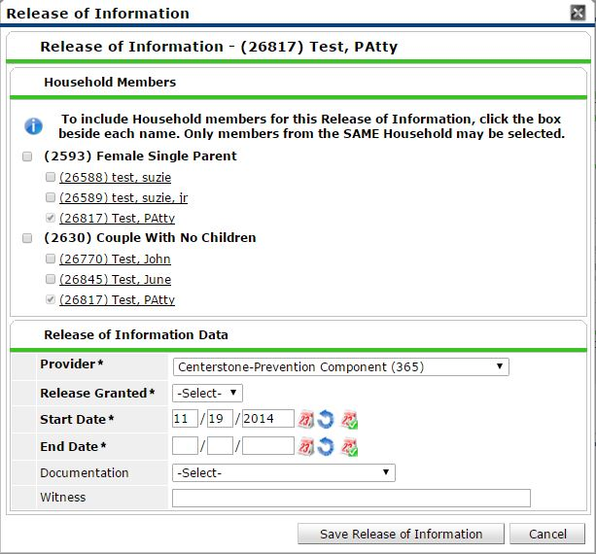
ROI tab
This will say None until you add an ROI.
1. Click “Add Release of Information.”
2. To tag multiple family members at once to be connected to this ROI, select the check marks beside their names. Remember, an original signed HMIS ROI must also live at the agency.
3. Release Granted = “Yes.” Fill in End Date. Documentation type should be “Signed Statement from Client.” Save Release of Information.

Slide 25
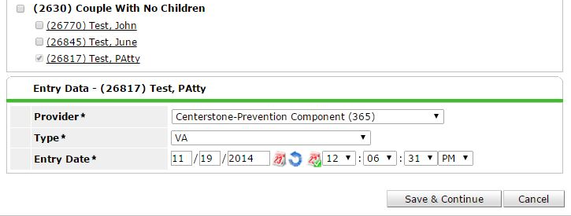
Entry/Exit tab
1. Click “Add Entry/Exit.”
3. The “Provider” will default to the EDA mode you have selected. Do not change.
4. For the “Type” dropdown, choose “VA.”
5. The Entry Date will default to the Back Date. Do not change date or time.
2. Tag each household member (if applicable).
6. Save and Continue.

Slide 26
Entry Assessment
Leave blank if no “secondary race” indicated.
1. Select answer.
2. If a client has no Health Insurance, complete HUD Verification (see following slides for instructions.)
3. If the client has health insurance, first select Add. A pop-up window will appear:
Notes:
Update screenshot

Slide 27
Entry Assessment
If you answered “Yes” to Health Insurance, and clicked “Add”:
Start Date auto-populates to Back Date. Do not enter End Date.
Select the Health Insurance Type from the dropdown (if “Other,” specify.)
Select “Yes” for “Covered?”
Save

Slide 28
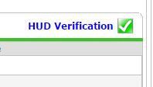
Entry Assessment
1. You must complete the HUD Verification sections (regardless of whether you answered “yes” or “no” that the client has any).
2. After adding any insurance source, click the “HUD Verification” red triangle.
3. Once you see this screen, select “No” at the top (this confirms that the client does not have any of the health insurance types that you did not select). This will fill in “no” for every answer choice that you did not choose.
4. Save & Exit.
5. You’ll end up with a green check!
Notes:
Update Screen Shot

Slide 29
Entry Assessment: Section 2
CoC Code (complete for HoH Only)
Complete for all adults.

Slide 30
Entry Assessment
1. Fill in total monthly income for this client.
2. Select the appropriate % AMI. This is based on annual income. Answer % AMI for HoH only (but be sure to include income sources from all family members).
3. If a client has no income, complete HUD Verification.
4. If the client has income, select Add. A pop-up window will appear:

Slide 31
Entry Assessment
1. Enter monthly income amount.
2. Select appropriate source of income. Always select the option with (HUD) following it.
3. Select “Yes.”
4. Leave end date blank.
5. Start date is pre-populated with Back Date. Check to make sure this = program enrollment date.
NOTE: If the client already has an income source listed in their entry assessment, but they are no longer receiving it, click on the pencil next to that income source to edit. Add an end date of the day before program enrollment date. Leave “Receiving Income Source?” as “Yes.”
Don’t forget HUD Verification.
Notes:
Update Screen Shot

Slide 32
Entry Assessment
Follow the same procedure as Income.
NOTE: If the client already has a non-cash benefit source listed in their entry assessment, but they are no longer receiving it, click on the pencil next to that income source to edit. Add an end date of the day before program enrollment date. Leave “Receiving Benefit?” as “Yes.”
Don’t forget HUD Verification.

Slide 33
Entry Assessment
Adults only
HoH only (see next slide)
Adults only (see the following slide)
HoH only
Notes:
Update Screen Shot

Slide 34
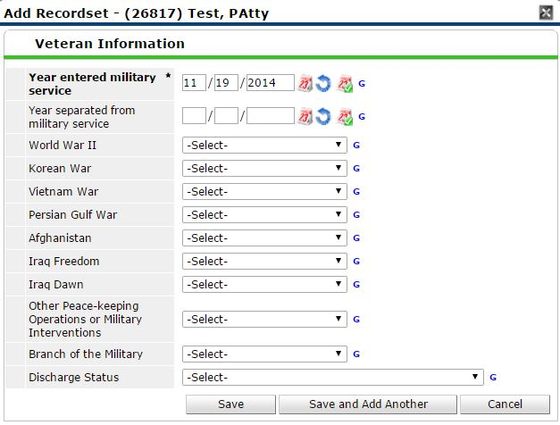
Entry Assessment
1. Select “Add” to input military service information. Required for HoH only.
2. Enter the Year entered military service, year separated from military service, select “Yes” for the appropriate military era. Leave all other military eras BLANK.
3. Select the branch.
4. Select the discharge status.
5. Save.

Slide 35
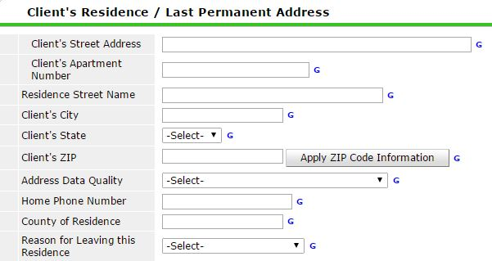
Entry Assessment
Enter the client’s last permanent address where they lived for 90 days or longer.
This does not include Emergency Shelters or Transitional Housing – they must have been or be in permanent housing).
Required for all adults.
Address Data Quality = “Full Address Reported” if we have complete street address, city, state, and zip code.

Slide 36
Entry Assessment
SSVF HP Targeting Criteria – HoH Only
RRH (Cat 2 and 3) Clients:
Leave all fields blank
Prevention (Cat 1) Clients:
Select appropriate answers for each question, and fill in HP applicant total points (integer) and Grantee targeting threshold score (integer).

Slide 37
Entry Assessment: Housing Move-In Date
Housing Move-in Date: To be entered only when Cat 2 or 3 client has been housed. Backdate to the appropriate move-in date and complete for every member of the household.
If there are household members:
On the left hand side you can click on a household member’s name and go directly to their Entry sheet. You can then enter data for the entry assessment for every household member. When you have finished entering all household members’ information, Save & Exit.

Slide 38
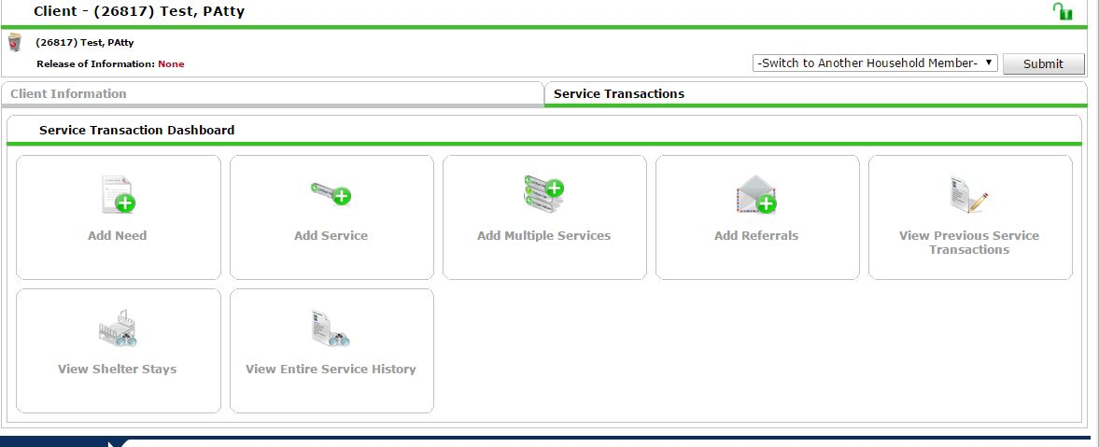
Service Transactions
We were on the Client Information tab – next we’re navigating to the Service Transactions tab.

Slide 39
Service Transactions
Click “Add Service”

Slide 40
Service Transactions
Only apply financial services to the head of household. Also only apply legal services and financial counseling to the head of household.
Apply all other non-financial services (e.g., case management, housing search assistance) to entire household, by checking the box next to the Household ID #.
The following window will appear:
There is a drop-down list of frequent service types, but you may have to select “Look Up” for some services
Start Date will pre-populate to entry date (back date). You may need to change this for financial services (start date should be the date the check was written).
End Date - For financial services, the start date = end date. This should be the date the check was written. For non-financial services, leave this field blank until they exit.

Slide 41
Service Transactions
After you have selected the appropriate service type, click Save and Continue.
For financial services , ONLY fill out “SSVF Financial Assistance Type” and “SSVF Financial Assistance Amount.”
For non-financial services (i.e., Stabilization Services – case management, housing search assistance, legal services, etc.): ONLY fill out “Type of SSVF Service”
Select “Add Funding Source.” A pop-up window will appear (pictured below). You may search for VA using the Search box, or you can select “Last” to go to the end of the list, where you will see VA. Click on the plus sign to add VA as the funding source.
In “Amount,” enter the $ amount of financial services. Enter $0 for non-financial services.
Save and Exit.

Slide 42
Exiting a Client
Back to the Client Information tab.

Slide 43
Exiting a Client
Choose appropriate Enter Data As mode.
ClientPoint: Enter HMIS ID in “Client ID #” field to directly locate the client’s record.
Back Date Mode: Back date to Exit Date.
Click on “Entry/Exit” Tab.
Click on pencil icon under “Exit Date.”

Slide 44
Exiting a Client
Exit Date populates to Back Date. Do not edit the time.
Select “Reason for Leaving” and “Destination” (if “Other,” specify). Avoid choosing “Other” if possible.
Save and Continue.

Slide 45
Exiting a Client
The Exit Assessment looks similar to the Entry Assessment. All fields will be pre-populated with information from the Entry Assessment.
If no exit interview was completed (e.g., because client disappeared), do NOT update any fields. Leave all fields as they were at entry.
If client is RRH, make sure the housing move-in date has been updated in the Entry Assessment for all clients. You should enter a move-in date for EVERY client who is permanently housed.

Slide 46
Exiting a Client
If client’s income, non-cash benefits, or health insurance changed from entry to exit:
If no sources listed at entry, and adding completely new source, click “Add,” and add new source as you would at entry.
If source ended at exit, or income amount changed at exit, click on the pencil next to existing source to edit. Add an end date of the day before exit date. Leave “Receiving Income Source/ Benefit/ Covered?” as “Yes.” To add new source/amount in its place, click “Add,” and add new source as you would at entry.
Make appropriate changes for ALL household members.
Save and Exit.

Slide 47
Questions? Contact the HMIS Help Desk: HMISHelp@nashville.gov

