Slide 1
Coordinated Entry Section 8 Application Training
Presented by the Metro Homeless Impact Division

Slide 2
What is Section 8?
Section 8 is a federal Housing Choice Voucher program that is administered locally by MDHA.
A household issued a Section 8 voucher is responsible for finding a market rate unit where the owner/landlord agrees to accept Housing Choice vouchers. The Section 8 voucher then subsidies the rent of the unit. The Section 8 subsidy is paid directly to the landlord and the household pays any potential difference.

Slide 3
Section 8 vouchers available through CE
 | Set Aside | Mainstream | EHV
Eligibility Requirements | Cat. 1 literal homelessness | Age 18 - 61 Disabling condition Cat. 1 literal homelessness + Housed with RRH | Cat. 1 literal homelessness + Housed with RRH
Referral Process | Care Coordination meeting | Care Coordination meeting Directly to RRH program | Care Coordination meeting Directly to RRH program
Application | MDHA packet | MDHA packet + Mainstream referral form | MDHA packet + EHV referral form

Slide 4
REFERRAL PROCESS

Slide 5
Referral Process – Interest List
Cat. 1 Literal homelessness
Household entered into CE with a VISPDAT
Document Ready
Front and back of ID all adults
Upload documents onto HMIS profile
Email Nashville CES@nashville.gov
Front and back of SS cards all household members (or proof of order)
Birth certificates all household members
Household is put on Section 8 Interest List
* If household is in DV CE, documents can be emailed to NashvilleCES@nashville.gov directly.

Slide 6
Referral Process – Care Coordination Meeting
Priority Pool made from Section 8 Interest List
Set Aside and EHV referrals made from Priority Pool.
Mainstream Diversions made from Priority Pool
Housing Navigator and Agency Section 8 Liaison receive referral email
Please do NOT fill out and upload application until a referral is made

Slide 7
Referral process – RRH households
RRH programs will receive an email from CE team regarding additional Mainstream and EHV availability each month.
*** MDHA only allows a certain number of applications to be submitted through Coordinated Entry each month. With this referral process, we are making sure that we submit as many eligible and complete applications as possible.

Slide 8
APPLICATION DETAILS

Slide 9
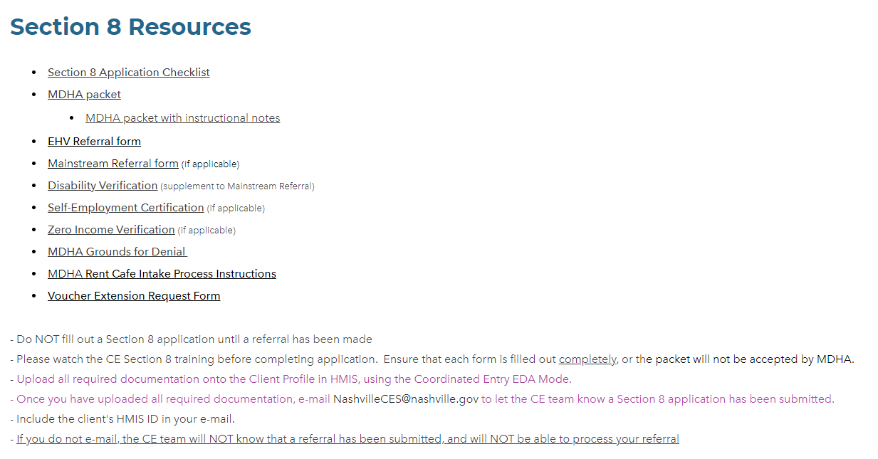
Weebly Screenshots
https://mhidnashville.weebly.com/forms-and-applications.html

Slide 10
Application
MDHA packet
EHV Referral Form, if applicable
Additional Supporting Documents
(not inclusive)
Front and Back State ID – All Adults
Front and Back SSC – All Members
Mainstream Referral Form, if applicable
Birth Certificates – All Members
Proof of Income
Proof of Non-Cash Benefits
Anything claimed on application needs documentation
Upload into HMIS
HN should fill out application with client.

Slide 11
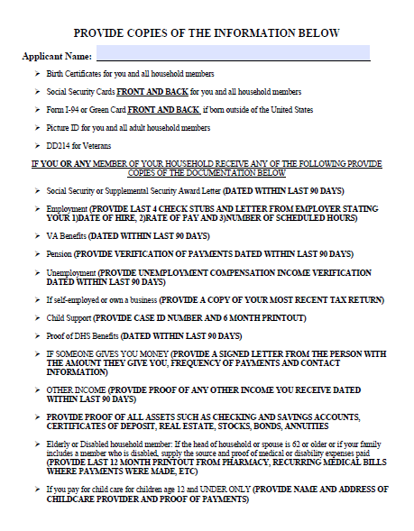
MDHA packet
A MDHA packet with instruction notes is uploaded onto the Weebly website.

Slide 12
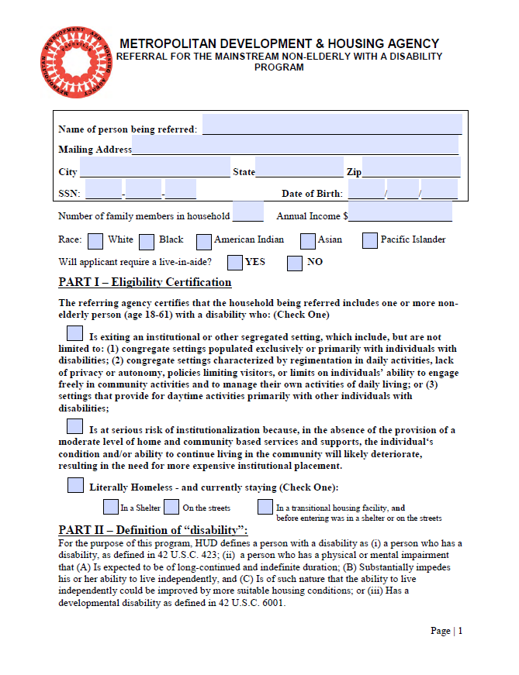
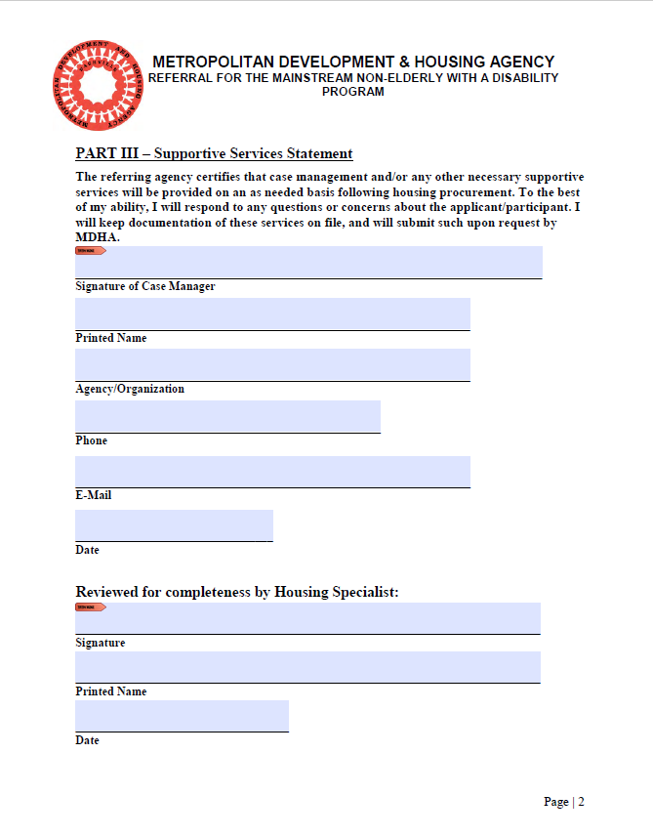
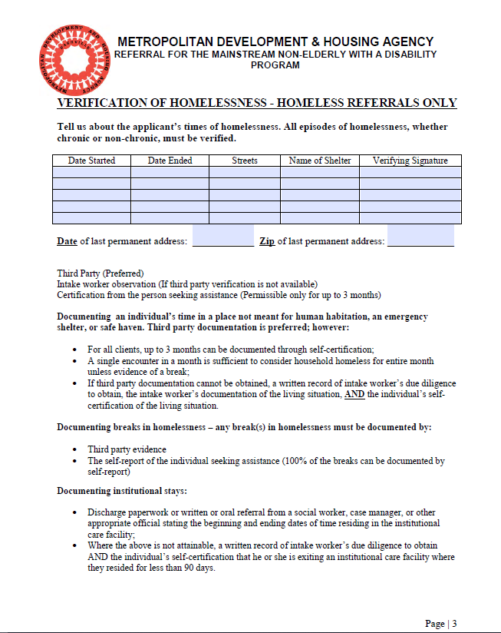
Mainstream referral form

Slide 13
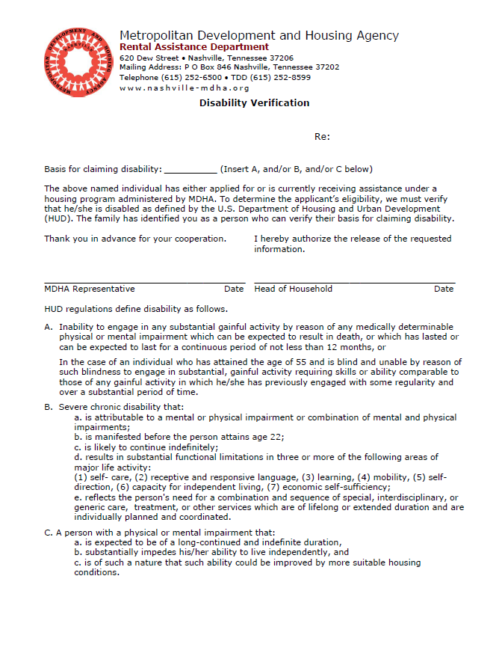
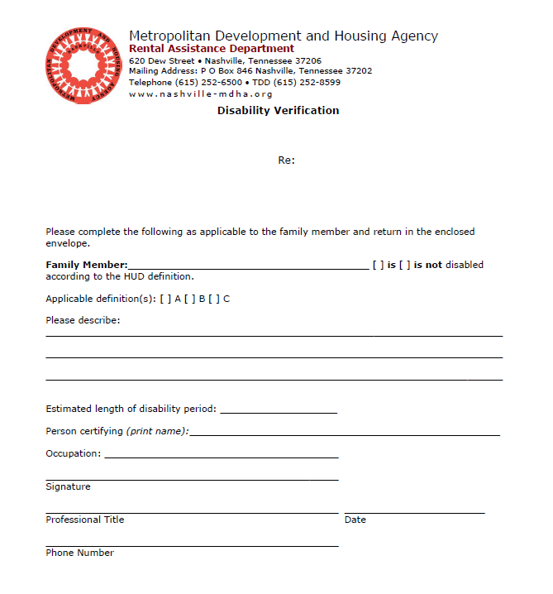
MDHA disability verification form
* Proof of disabling condition can be SSI/SSDI print out OR completed MDHA Disability Verification form

Slide 14
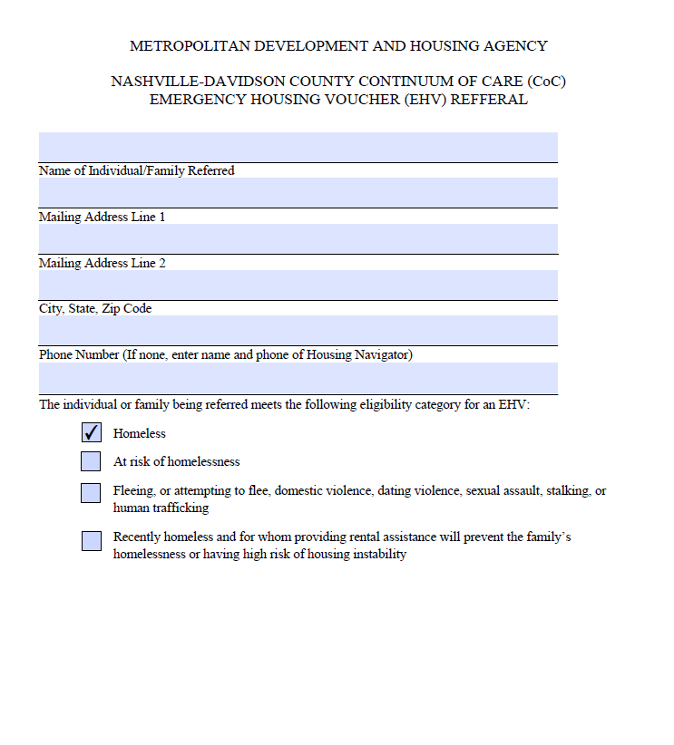
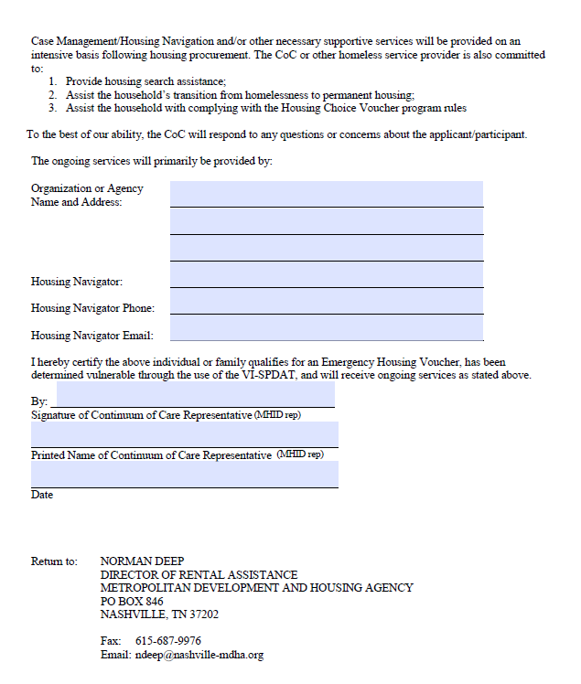
EHV referral form

Slide 15
Submitting Application
Have Agency Section 8 Liaison review application
Upload application and potential referral form onto the household’s HMIS profile
Email NashvilleCES@nashville.gov
MHID will review, provide edits and submit to MDHA
MDHA will review and either approve or deny
If approved, briefing documents will be sent to Navigator to complete and return to MHID

Slide 16
AFTER SUBMISSION

Slide 17
Application approval
MDHA has approved application
Navigator completes briefing documents
Email briefing documents to NashvilleCES@nashville.gov
Briefing documents are sent to Housing Navigator
MHID submits briefing documents to appropriate MDHA contact
MDHA send voucher to MHID and MHID forwards to Navigator
Navigator returns copy of signed Voucher for MDHA records

Slide 18
Briefing documents
The following briefing documents need to be signed and returned:
HMIS Intake Form
HMIS Release of Information
Original Change of Circumstances Packet
Receipt of Briefing Materials – 1st page tenant handbook
* Also included in briefing documents:
Landlords that Accept Section 8 vouchers
How the Program Works
Tenant Handbook

Slide 19
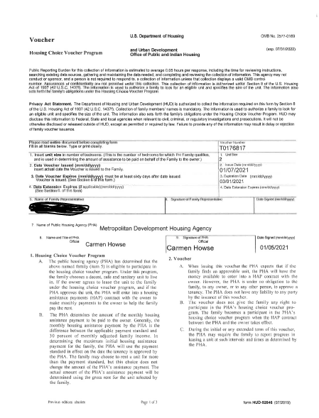
Voucher
Voucher will be sent ONLY after signed briefing documents and supporting documentation are returned.
MDHA needs a signed and dated copy for their records.

Slide 20
Navigator responsibilities
Unit location
It is a C’s responsibility to find their own unit
Resources are available to help with housing search: Low Barrier Housing Collective website, TN Housing search, MDHA list of landlords
Voucher extension requests
The link to the Voucher extension request form can be found on the Weebly website
Submit extension form at least 2 weeks before voucher expires
Potential Move in Costs
There are landlord incentives attached to the EHV vouchers- MHID’s Lizzie Goddard can answer questions
How’s Nashville financial assistance through Coordinated Entry for deposits, first month’s rent, etc.

Slide 21
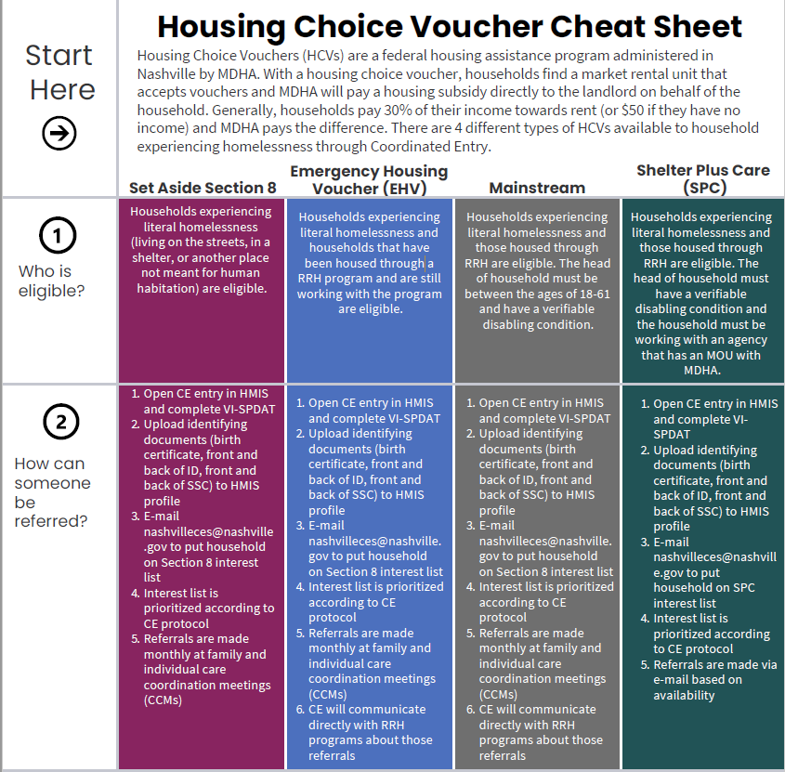
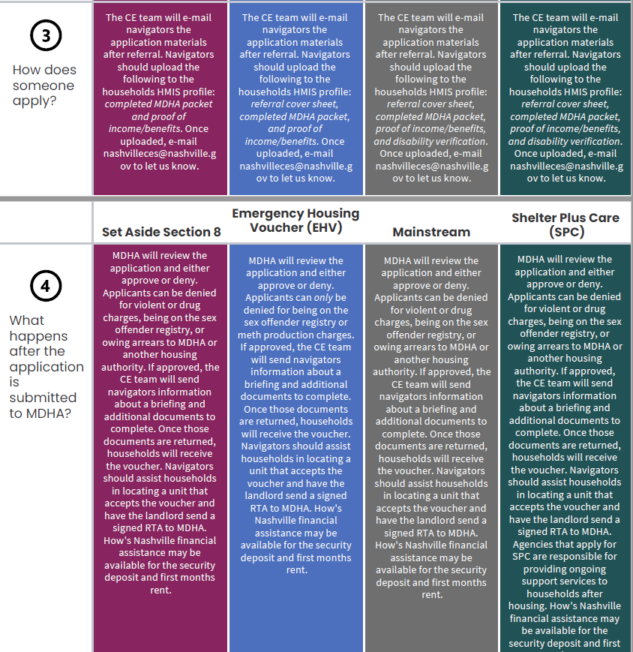
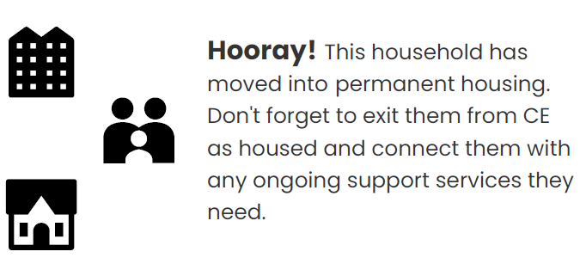
Cheat Sheet

Slide 22
Thank you for completing this training!
Please email any questions you have about the Section 8 application process to NashvilleCES@Nashville.gov

